Slide 1
Emerging Technologies Accelerating Auditing and Governance:
From NLP to Virtualization and Trustworthiness
Dr Ramzi Ben Ouaghrem
CTO & Technical Executive, IBM MEA
www.linkedin.com/in/benramziben

Slide 2

Discussion topics
Technology eminence for the Digital Transformation
How to extract insight from unstructured data?
Should we really trust AI?
What if we have a full integrated GRC platform that help us also manage auditing?
© 2022 IBM Corporation

Slide 3


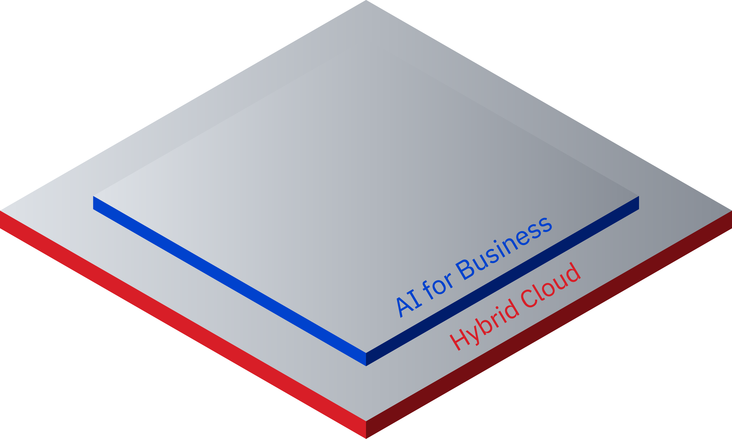

Technology eminence ↷
will define the winners
Automate productivity at scale
Secure all touchpoints, all the time
90% of organizations and governments are engaged in an enterprise-wide digital transformation
90% of data is untapped
80% of enterprises agree intelligent automation improves business results
40% increase in malicious security breaches
Data-driven to predict outcomes
Modernize for agility and speed
Transform how your business works

Slide 4

Getting inspired…

Slide 5

1 billion
Auditors:
More time on improving operational efficiency, less time on reviewing documents for accuracy
and compliance
Knowledge workers in the world
Believe the difficulty of finding information is a
key cause of lagging productivity in the office
57%
30%
Knowledge workers’ time spent navigating through data to find the information they need to do their work
Informed decisions require non-routine, human-in-the-loop analytical thinking
Establish relationships and make connections
Evaluate complex or conflicting priorities
Identify and understand trends
Understand “cause and effect”
Due Diligence Analysts:
More time analyzing strategic options, recommendations and deal execution, less data gathering and cross-document analysis

Slide 6

Use Case
E&Y
M&A due diligence
Industry: Professional Services
Geography: EMEA (United Kingdom)
  EY Diligence Edge provides EY transaction professionals with an outside-in view of a target company and its competitors.
  EY Diligence Edge can consolidate and analyze a range of external information, including news, financial and social media data, to assist M&A practitioners in providing strategic recommendations at the click of a button.
3-5 days
vs. 2-3 weeks
for insights
10-20%
Effort reduction
Up to 50k
Documents processed each month

Slide 7






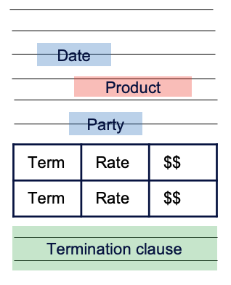
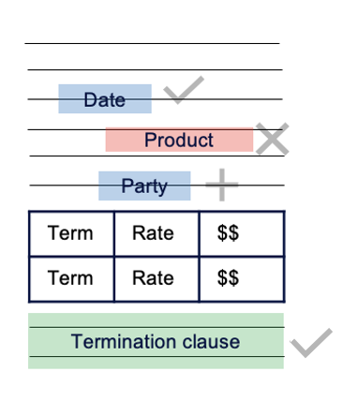
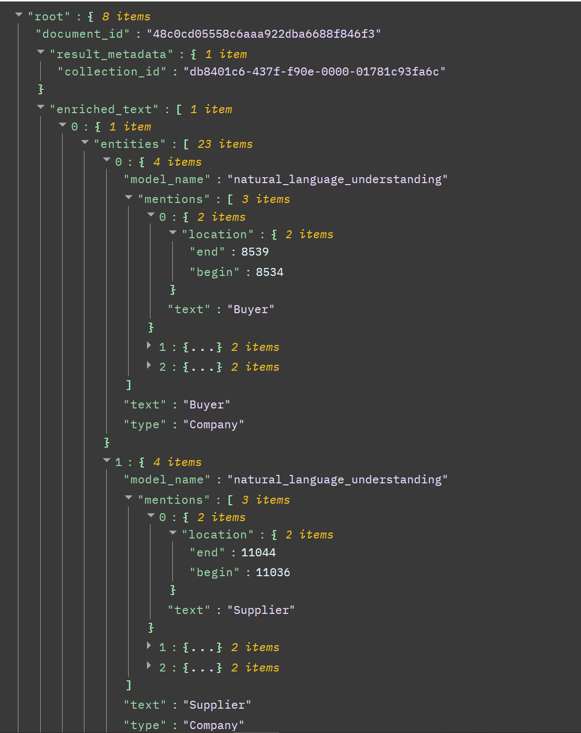
Our vision is to augment a worker’s ability to understand the corpus of complex, high value documents needed for business decisions
80% of data is unstructured – Innovation helps understanding the language of business documents
Analyze
Extract
Extract data from human-read documents (pdf, ppt, word, html)
Enrich
Enrich text with most advanced out of the box NLP
Enhance
Teach Discovery to improve with input from business users
Navigate
Automate
7

Slide 8
EXTRACT
Smart Document Understanding
Visually teach Discovery how to interpret document structure and components
Discover deeper insights by using extracted content (such as table header or abstract) in queries, to segment documents, ignore irrelevant parts and more
Even identifies text in scanned business documents and document pictures (OCR)
Train Discovery to understand complex and domain specific tables
Enables Auditors to: get more accurate insights and answers
IBM Watson Discovery | DOC ID | © 2021 IBM Corporation
8

Slide 9
ENRICH
Custom Natural Language Processing (NLP)
Out of box models that understand:
Keywords
Entities
Concepts
Document sentiment
Advanced NLP customization.
Enables Auditors to: teach the language of their business domain to surface more insights
© 2022 IBM Corporation

Slide 10
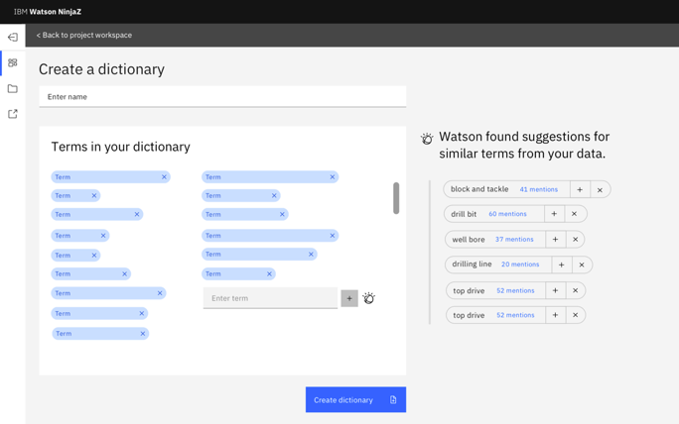
ENHANCE
Rapid Model Development
Build a custom dictionary for use as annotations or facets quickly
UI provides recommendations for similar terms to quickly build the dictionary
Requires no additional software – learns from knowledge that exists in your corpus
Can be performed by business user or anyone with domain knowledge
Enables Auditors to: quickly build a dictionary from scratch to provide deeper understanding of the user’s business and domain.
IBM Watson Discovery | DOC ID | © 2021 IBM Corporation

Slide 11
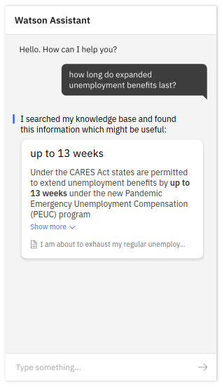
ANALYZE
Answer Finding
Previously, The Technology would identify the best “passages” that correspond with queries. Now, Answer Finding is much more precise through a new process:
Retrieves candidate paragraphs from the set of enterprise documents
Searches for the precise answer to the question at hand
Produces a concise answer
Enables Auditors to: return a fact or short answer from a long passage

Slide 12





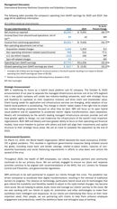
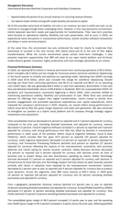
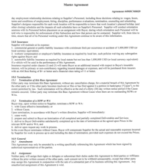
Knowledge worker workflow powered by Watson Discovery
Accelerate insight processes
Watson Discovery delivers capabilities that enable these applications across the enterprise
Use Case: External Audit
1
2
3
4
5
Identify relevant documents based on audit context
(annual reports, agreements, contracts)
Read through documents to find
key facts related to
the assessment (revenue numbers, policy changes)
Research questions to relate uncovered facts to
potential risks
Gather supporting evidence from across other sources
Combine to form
a reliable recommendation
Extract
Conversion for multiple content types
Table Understanding
Enrich
Out of the box NLP
Built-in knowledge for common facts
Enhance
Business-specific extraction
SME led training
Analyze
Query and explore data
Retrieve relevant data
From Weeks to Days using AI

Slide 13


Use Case
ContractPodAI
Contract Lifecycle Management
Industry: Legal
Geography: EMEA (United Kingdom)
Logo
ContractPodAI is a UK-based startup that makes AI-powered tools for attorneys to write and analyze contracts. It also helps clients find post-execution contracts throughout the enterprise.
Advanced AI helps them identify key contractual clauses and detect when the semantic meaning of key sentences has changed during the redlining process. These differentiating capabilities have helped the company grow explosively in the past two years and gain recognition from analysts.
>400,000
Contracts in inventory
50%
faster contract renewals
© 2022 IBM Corporation

Slide 14
However….

Slide 15

IBM’s 3 Principles for Trust and Transparency
The purpose of AI is to augment human intelligence
Data and insights belong to their creator
New technology, including AI systems, must be transparent and explainable.
Notes:
3 Principles

Slide 16





What does it take to Trust a decision made by an AI?
We started from these HUMAN-CENTRIC questions
Is it easy to understand?
Is it
fair?
Did anyone tamper with it?
Is it accountable?
Does it safeguard data?
EXPLAINABILITY
FAIRNESS
ROBUSTNESS
TRANSPARENCY
PRIVACY
Easy to understand outcomes/decisions
Why did the AI arrive at an outcome? When would it have been different?
Impartial and addressing bias
Are privileged groups at a systematic advantage compared to other groups?
Handle exceptional conditions effectively
Can we evaluate and defend against a variety of threats?
Open to inspecting facts and details
Can we increase understanding of why and how AI was created?
High integrity data & business compliance
How do we ensure owners retain control of data and insights?
Notes:
Phaedra

Slide 17
What is Trustworthy AI?
Trust in Models
Increase insight accuracy with improved model development, validation and bias detection.
Trust in Data
Deliver a complete view of quality data that is governed and ready for analysis.
Trust in Data
Trust in Models
Trusted AI
Trust in Process
Ensure compliance, repeatability and overall explainability for AI at scale.
Trust in Process

Slide 18
AI Development Lifecycle
A modular approach to address Trustworthy AI challenges across the lifecycle
  Model Inventory, E2E Fact collection & consolidation
Trust in
Models
  Model Monitoring & Evaluation
Model Proposal
Model Approval
Ongoing Monitoring of Production Model
Model Development and Unit Test
Pre-Implementation Review
(Validation)
Model Deployment to Production
  Process, Approvals, Attestations, Risk Assessment, Management and Reporting
Trust in
Process
  (Data) cataloging, lineage & policies
Trust in
Data

Slide 19





The call for transformation:
How to effectively manage risk, set efficient governance rules and comply with regulatory change
Visibility into regulatory changes, managing impacts
Consistent, aggregated views of risk across organization
Quality of GRC data and friction among data siloes
Accountability of enterprise risk and compliance activities
Reducing likelihood of unexpected risk events

Slide 20

Automated GRC enables
Fully Integrated Audit, Enterprise Risk and Compliance Management
  Integrated platform and data model across all risk & compliance processes
  Leveraging cognitive & AI to help improve efficiency & effectiveness across the organization
  Enable risk-aware decision making
  Ensure compliance
  Improve business performance
Across the entire enterprise

Slide 21
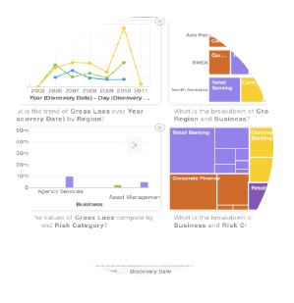
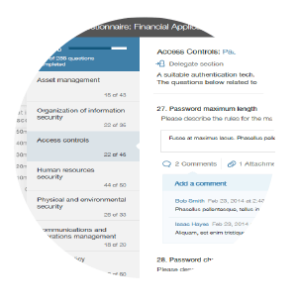

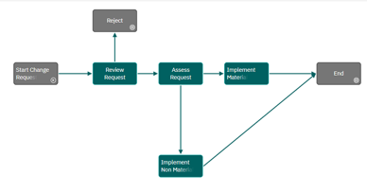
Fully Integrated, Flexible Enterprise Risk Platform
Data Privacy
IT Governance
Internal
Audit
Vendor
Risk
Regulatory
Compliance
Enterprise
Risk
Regulatory
Change
Policy
Compliance
ESG
Advanced
Analytics
Model
Risk
Business
Continuity
Financial
Controls
Dynamic Questionnaire
Dynamic, Object Model, zero training UX
AI capabilities
Integrated
Questionnaire
Flexible Workflows
Worflow

Slide 22

Use Case
Citibank
Understand risks and comply with regulations
Industry: Banking
Geography: North America
With one of the largest corporate audit departments in the world, Citi has 2500 auditors going through documentation reviews and risk assessments. Citi needed to plan and scope audits more effectively.
IBM helped Citi save hundreds of thousands of billable hours each month, reducing the processing time for the thousands of transcripts between their agents and customers.
2,500
Internal auditors
100,000s
billable hours saved monthly
© 2022 IBM Corporation

Slide 23
Take away
AI dramatically accelerate the value knowledge workers (i.e. Auditors) deliver
Need to establish a governance culture to trustworthy AI
Trusted data is critical for AI adoption
Use of an integrated platform to manage Audit and Compliance efficiently

Slide 24
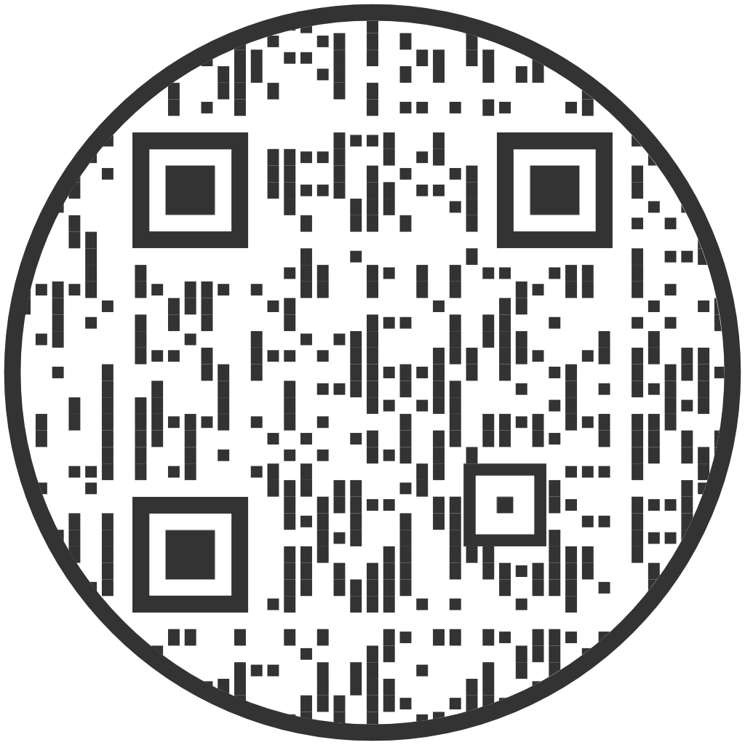
Thank you
To stay in contact feel free to
scan the QR code

