Slide 1

Good Bad & Ugly
Why Should I care
Governance of IA
Dr. Alok Tuteja,
Phd, DTM, CISA, CRISC, CGEIT, CISSP, CIA, PMP

Slide 2
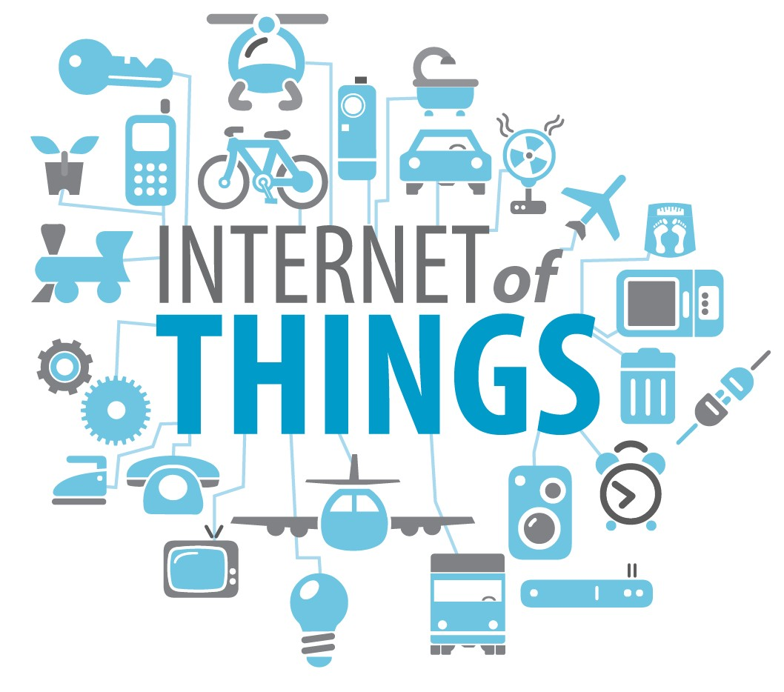
Why do you care?

Slide 3

2 MI LLI ON
72 HOURS
20 4 MI LLI ON
1.8 MI LLI ON 278 THOUSAND 11 THOUSAND
Google Search
Upload on YT
Emails
Likes
Twitter
LinkedIn

Slide 4

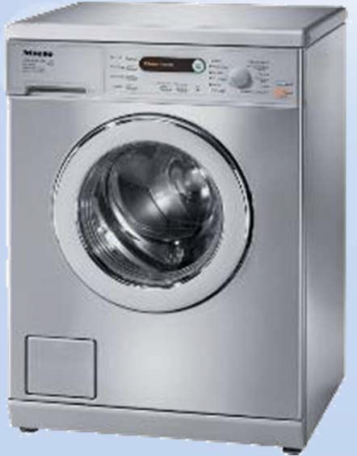
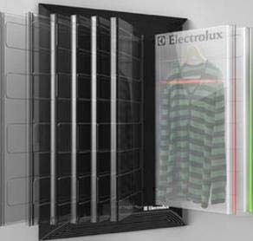





Today’s Washing Machine
Tomorrow’s Washing Machine?
Waterless Molecular Technology
Learning Material & Damages
Scan textiles for impurities
Embedded in Wardrobe
9

Slide 5
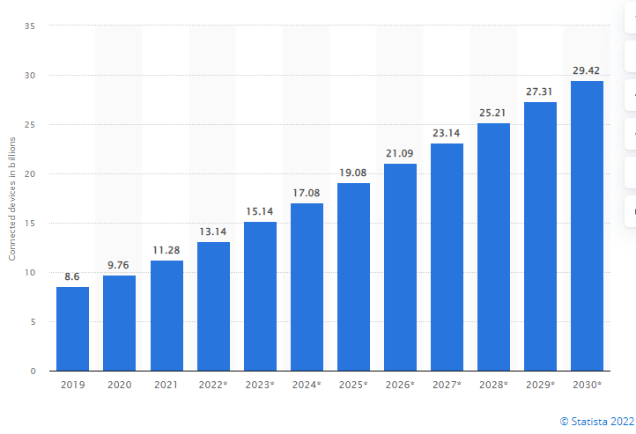
Growth of IOT from 2019 to 2021 and estimate 2021 to 2030
The new Internet will be made up of machines talking to each other.

Slide 6
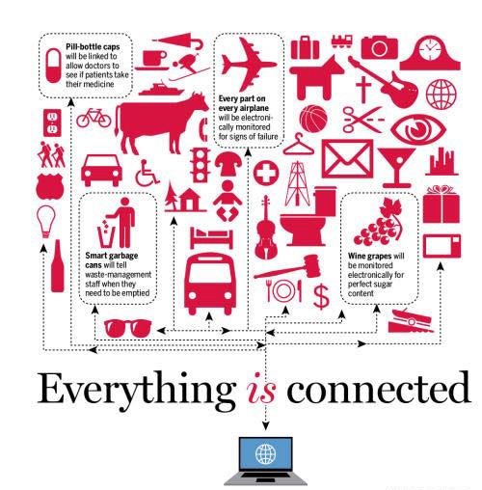
Why now?
A number of significant technology changes have come together to enable the rise of the IoT over the last 10 years. These include the following:
Cheap Sensors
Cheap Bandwidth
Cheap Processing
Smartphones
Ubiquitous Wireless Coverage
Big Data
IPv6

Slide 7
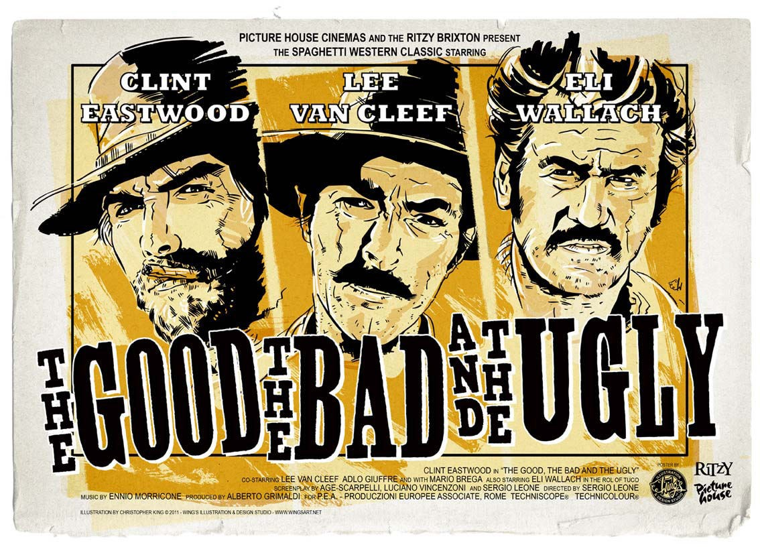

Slide 8
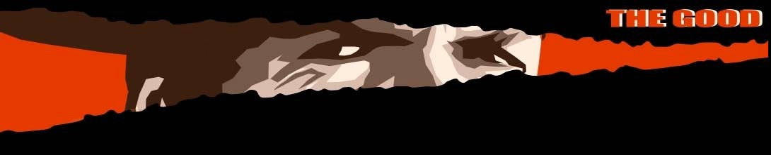
“We evolve because we communicate”

Slide 9
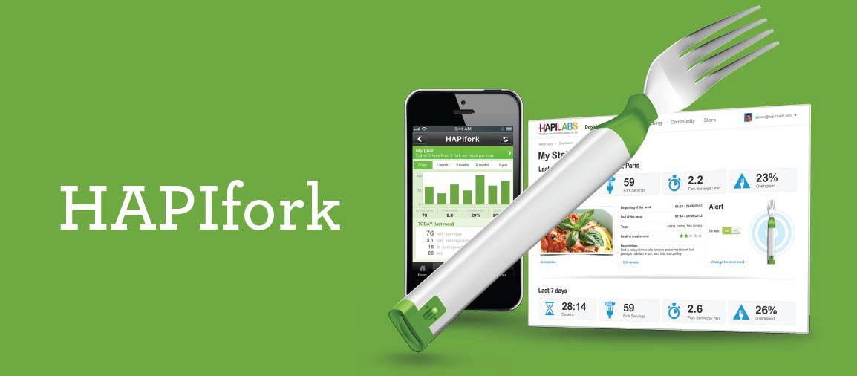
An electronic fork that helps you monitor and track your eating habits. It also alerts you with the help of indicator lights and gentle vibrations when you're eating too fast.

Slide 10
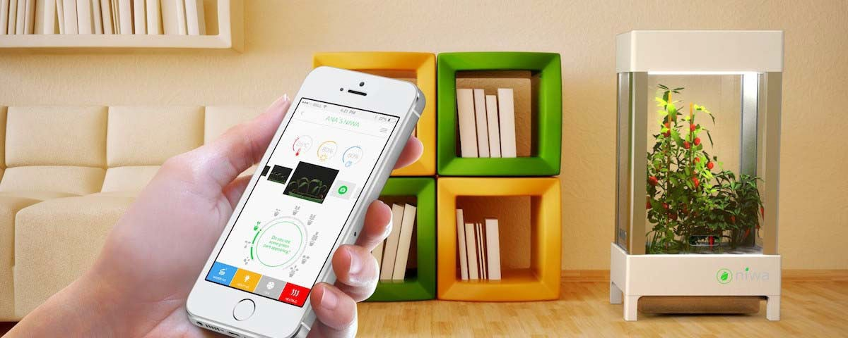
Niwa is the first fully automated hydroponic system that attends to all of your plants’ needs and water them, feed them and make sure they have optimal growing conditions 24/7.

Slide 11
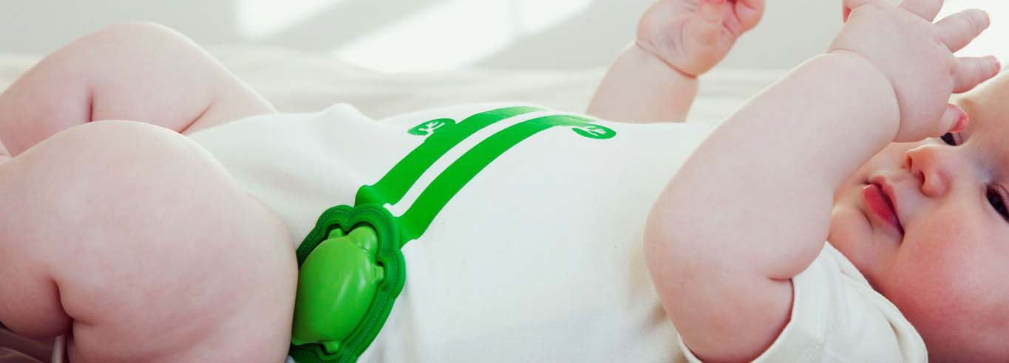
The Mimo baby monitor has respiration and temperature sensors, providing you with the necessary information with just a quick peek at your app. You can also check their movements and body position to see just how active or peaceful they are, no matter where you or your baby might be.

Slide 12
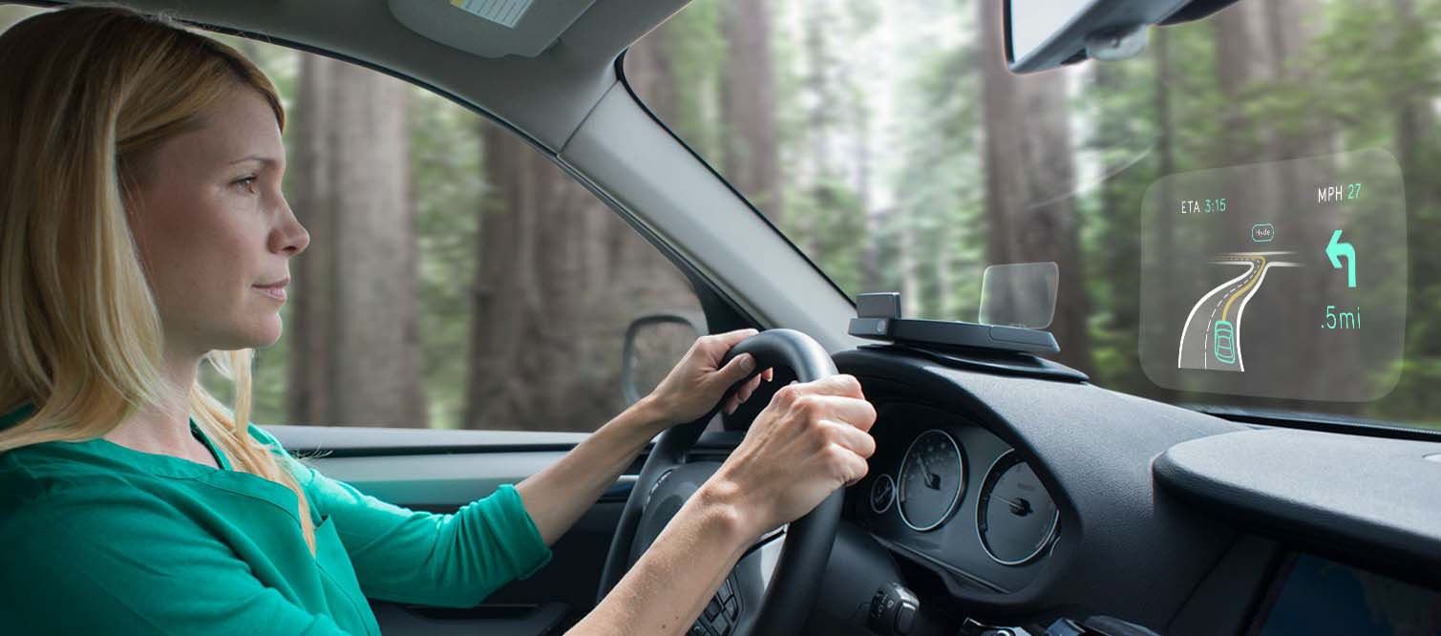
If the driver exhibits stress, the vehicle's coordinated sensors soften the lights and music, and broaden the headlight beams to compensate for loss of vision. A distressed state is broadcast as a warning to other motorists by changing the color of the vehicle's windshield.

Slide 13
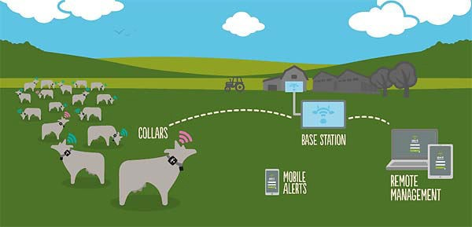
Sparked, a Dutch start-up company has created Systems that keeps track of a cow's health. A sensor attached to the animal reads its vital signs and transmits a mass of data wirelessly to a computer, which crunches the numbers and sends relevant messages to the farmer.

Slide 14


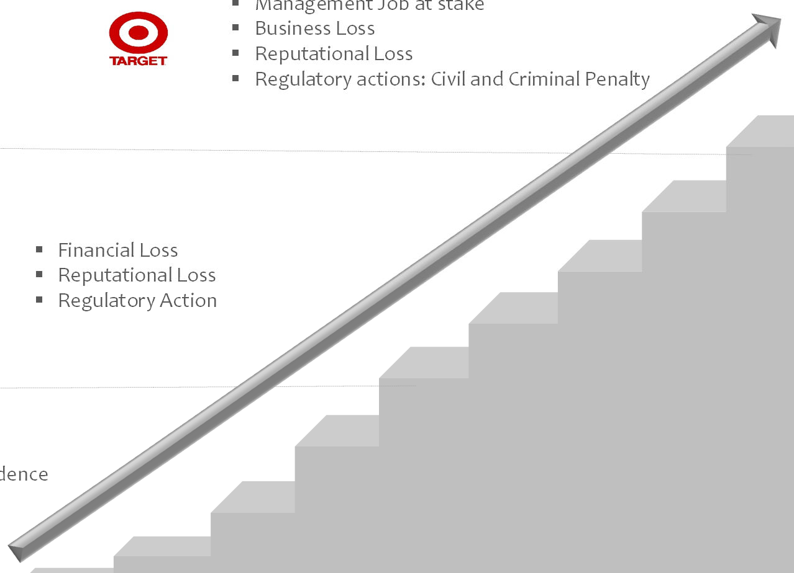




The risk implications
Changing Privacy Landscape with awareness amongst customers, users and stringent regulatory requirements
Security Realignment…
2010 & onwards
Management Job at stake
Business Loss
Reputational Loss
Regulatory actions: Civil and Criminal Penalty
Financial Loss
Reputational Loss
2000s
Regulatory Action
idence
1990s
Loss of customer conf
Regulatory warning
31
© 2014 KPMG, an Indian partnership and a member firm of the KPMG network of independent member firms affiliated with KPMG International, a Swiss cooperative. All rights reserved.

Slide 15
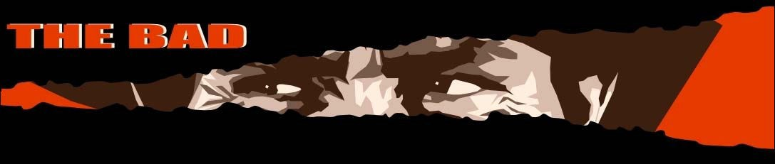
“Transformational is an overused word, but I do believe it properly applies to these technologies, particularly to their effect on clandestine tradecraft.”
David Petraeus Former Director of the CIA

Slide 16

On October 19th, security firm SOCRadar identified over 2.4 terabytes of exposed data on a misconfigured Microsoft endpoint. By SOCRadar’s account, this data pertained to over 65,000 companies and 548,000 users, and included customer emails, project information, and signed documents.
Microsoft acknowledged the data leak in a blog post.
were affected.

Slide 17

In 2022, 9.7 million accounts of Medibank customers, including credit and debit card information were stolen by an of cyber hackers.

Slide 18
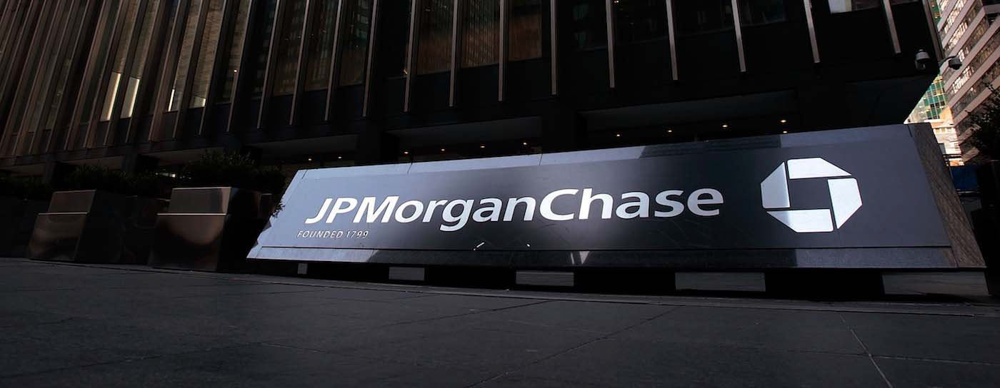
One of the costliest cyber attacks in history, the data breach in Epsilon, the world’s largest provider of marketing and handling services to industry giants such as JP Morgan Chase and other major financial services, retailers and other major companies in 2011, has an estimated damage cost that ranged from $225 million to $4 billion dollars.

Slide 19

“You can’t rush perfection”

Slide 20
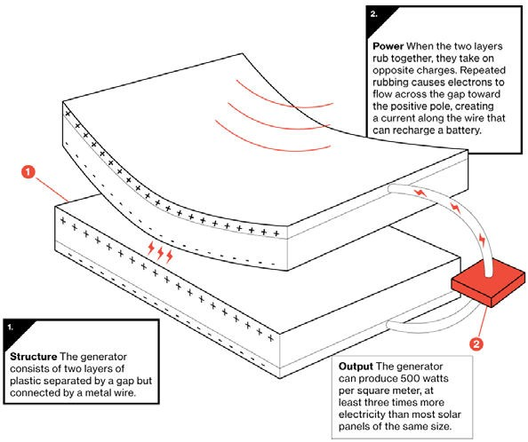
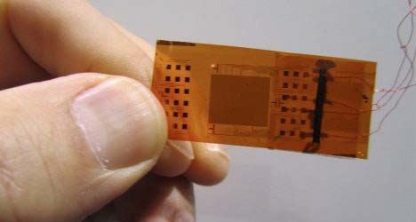
Challenges
Several barriers, however, have the potential to slow the development of IoT.
Deployment of IPv6
Sensor energy
Lack of Common Standards
The energy efficiency of a new piezoelectric nanogenerator has increased by almost 40 times, one step closer toward the commercialization of flexible energy harvesters that can supply power infinitely to wearable, implantable electronic devices.

Slide 21
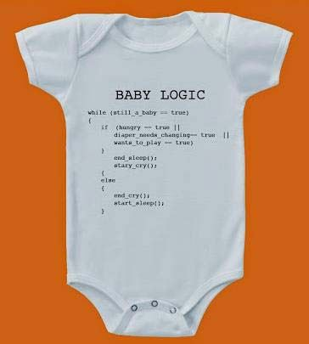
L
* Learning a computer language will be more important than a human language

Slide 22
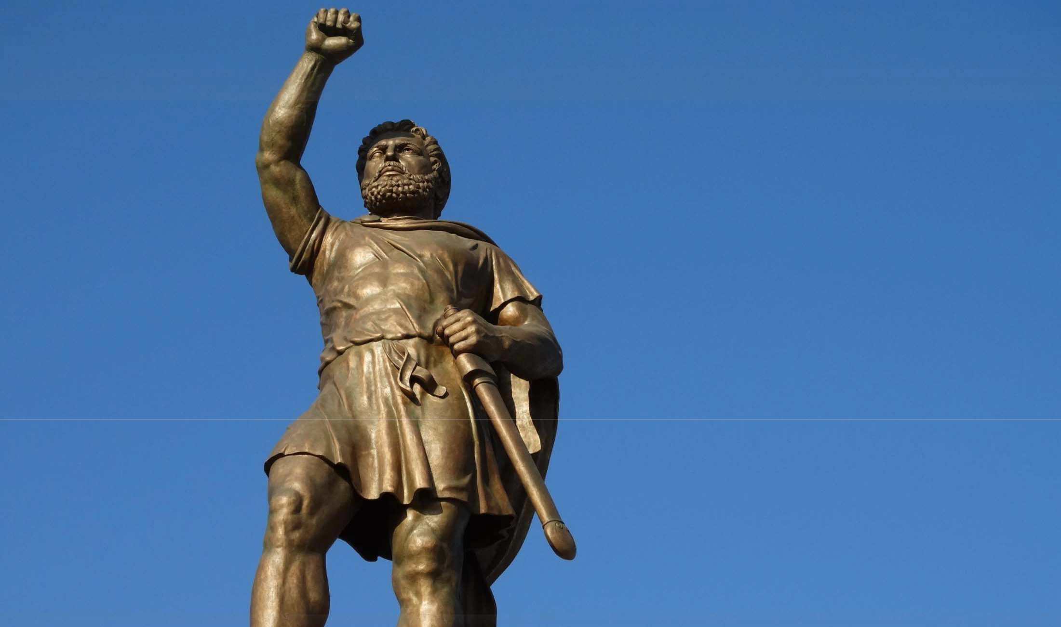
*Technology will make it possible what history could not…
59

Slide 23
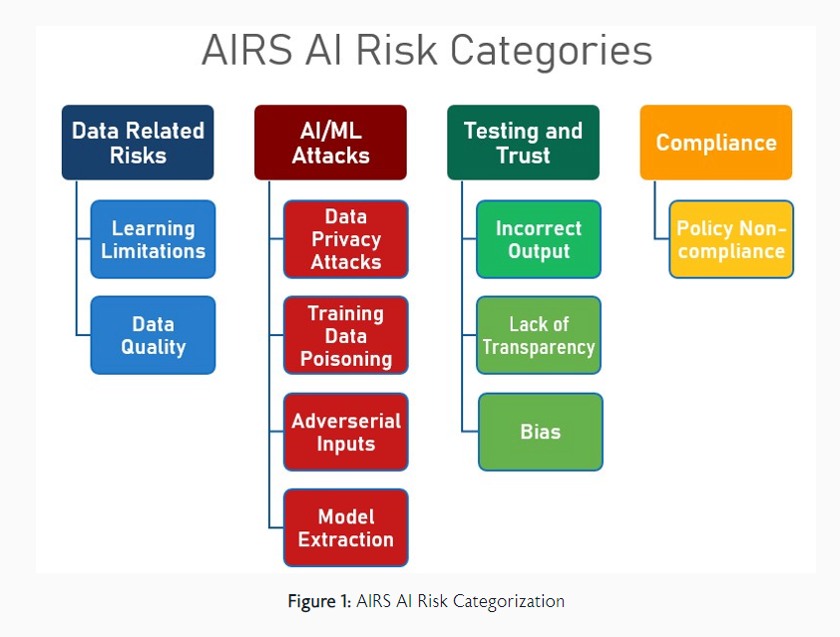
“You can’t rush perfection”

Slide 24

Éléments of AI Governance
Framework based approach
A agreed definition of AI/ML
A separate policy on AI/ML
Roles and responsibilities of AI/ML
Centrally managed AI operations
Appropriate Budgets
Inventory of AI Systems

Slide 25
Governance
Governance—
Exercise of authority;
Control;
Through rule, laws, etc.

Slide 26
Separating Governance From Management
Governance V/s Management
Business Needs
Governance
Evaluate
Direct
Monitor
Management Feedback
Management
Plan
Build
Run/Operate
Monitor

Slide 27
What we could do in Governance
Oversight – Board Level (Audit & Risk Committee)
Internal Control Framework (
Independent AI Internal Audit & Cyber Security Function
Segregation of Duties & Authority

Slide 28
Four Lines of Defence
Board Committees – Governance Level
  Audit Committee
  Risk Committee
  Compliance Committee
  Executive Compensation Committee
Policies
  Ethics Policy
  Fraud Prevention Policy
  Compliance Policy

Slide 29
Risk
Reputational
Financial
Legal
Human Resources
HSE

Slide 30
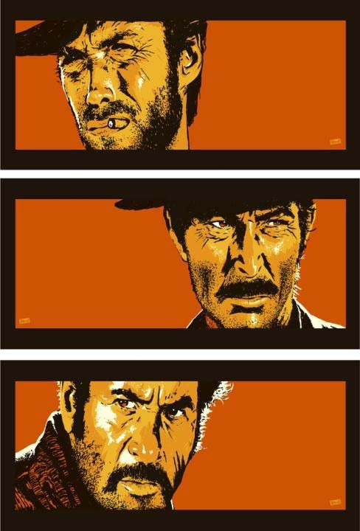
‘There are two kinds of spurs, my friend.
Those that come in by the door, & those that come in by the window. ’
-Yuco [ Good Bad Ugly]

Slide 31
Before I go…
We get paid for managing risks
Its impossible to be perfect at your job
Keep your mind open to new possibilities
If the last few years of technology developments surprised you, visit your cardiologist over the weekend
Change your risk assessment lenses!

