Slide 1
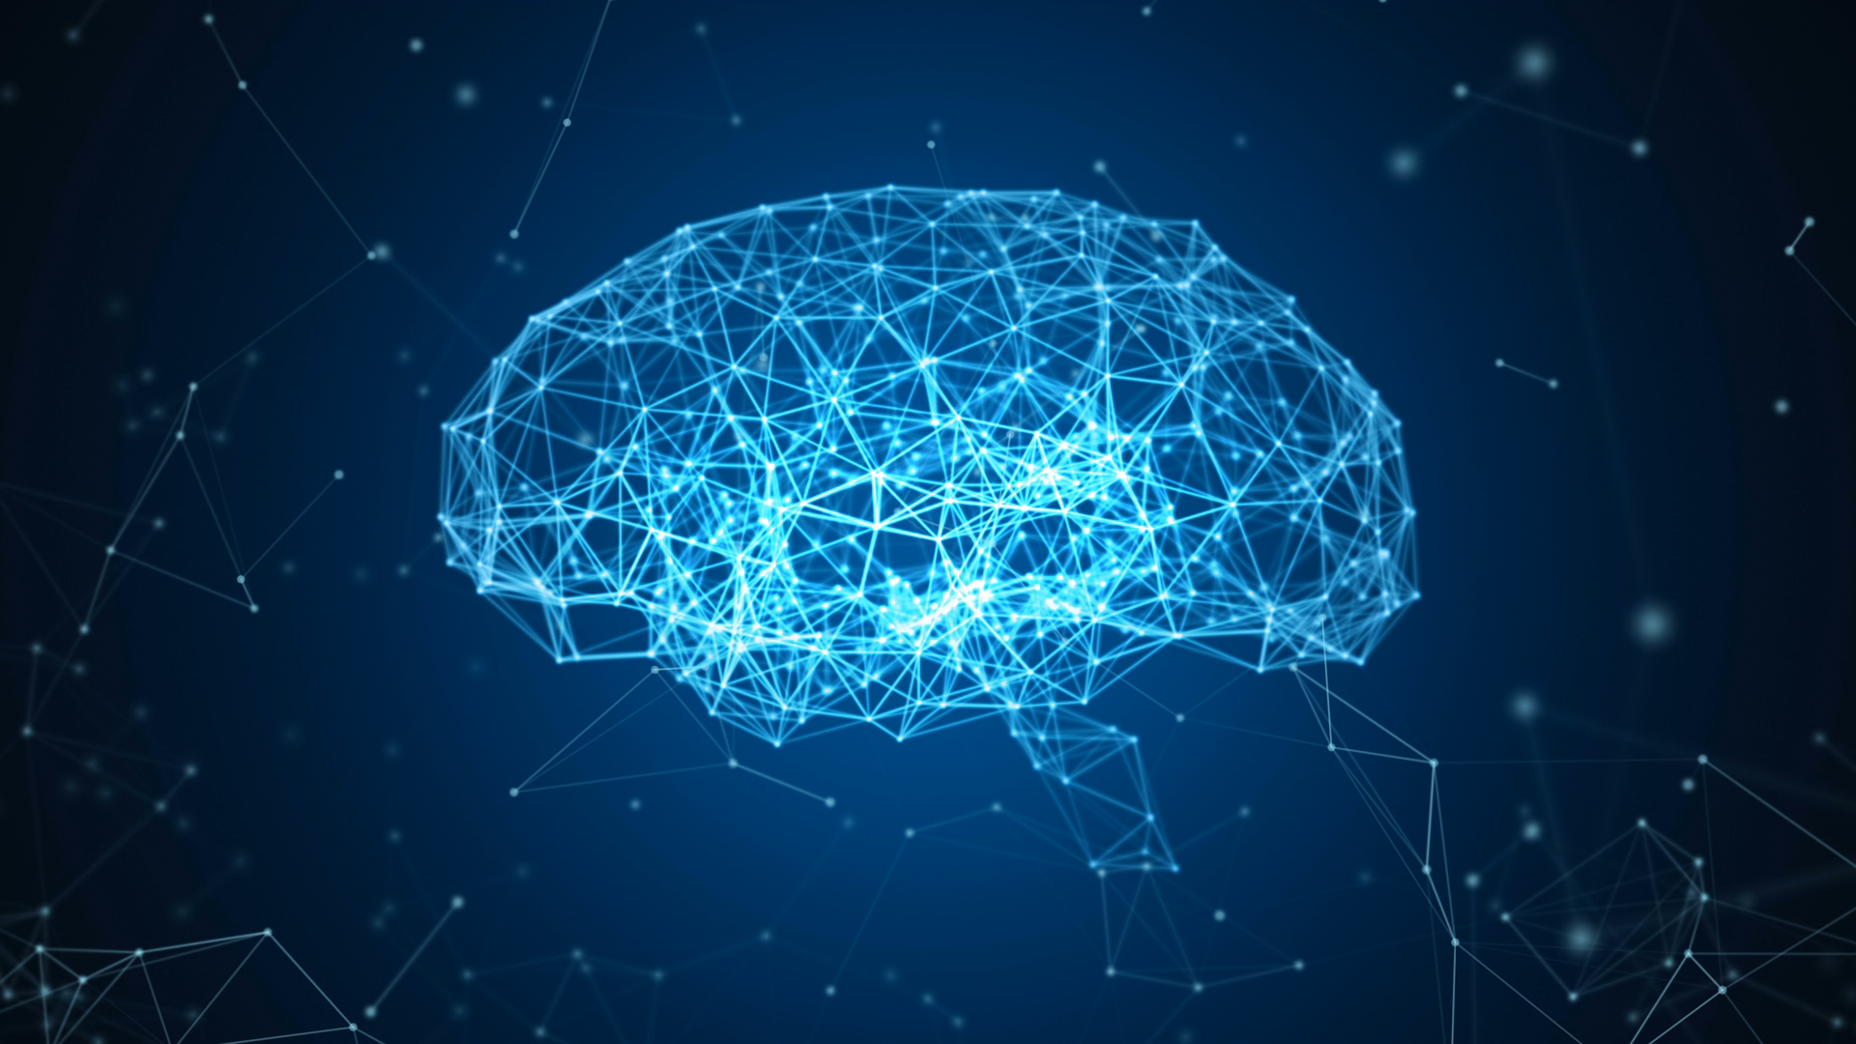
AI Pipelines from Data to Insights
Dr. Abdelrahman AlMahmoud
WGISTA First Annual Seminar

Slide 2
Outline
Recap
Introduction
Overview of AI Pipelines
Examples of high impact initiatives

Slide 3



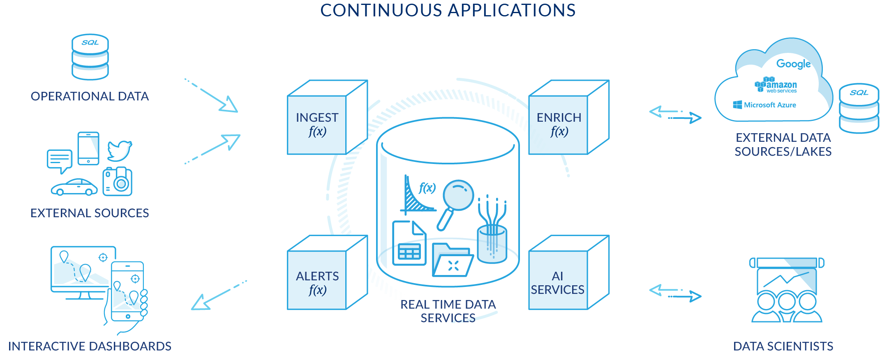
Overview
Filter
Fuse
DOMAIN EXPERTS
Ingest
Prepare
Model
Evaluate
Data
ML
OUTPUT

Slide 4

AI Pipelines from Data to Insights
Dr. Abdelrahman AlMahmoud
WGISTA First Annual Seminar

Slide 5
Outline
Recap
Introduction
Overview of AI Pipelines
Examples of high impact initiatives

