Slide 1



Central Bank Digital Currency (CBDC) Cyber Security Lesson Learned (Aber Project)
Annual WIGISTA Seminar
“AI, Innovation, Governance and Auditing: Challenges and Opportunities”
Meeting of the CBDC Working Group
December 08, 2022

Slide 2

TABLE OF CONTENTS
About Aber…………………….………………………………………………………………………..………..…………. 04
Similar Projects ……..………………………………………………………………………………………….…………. 06
Project Objectives……..………………………………………………………………………………….…..…………. 08
Project Phases……..………………………………………………………………………………………..…..…………. 14
Challenges and lesson learned………………….……………………………..………………..…..…………. 17

Slide 3
BUMPER SLIDE HEADLINE
Cryptocurrencies are one specific usage of Blockchain technology
Blockchain can be used to solve many more real-life business challenges without the fallacies of cryptocurrency
Cryptocurrency
Exchange of digital currencies using cryptography
Crypto currency = Bitcoin
Fully decentralized
Anonymous participation, Transparent activity
Blockchain
Implementation of DLT
Exchange of data/currency/assets..
Chain of blocks
Consensus-Based and Transactional (Consensus)
SUBHEADING HERE
Distributed and Sustainable (Finality)
Secure and Un-editable (Immutability)
Transparent and Auditable (Provenance)
Consensus-Based and Transactional (Consensus)
Flexible and Orchestrated
(Smart Contract)
distributed ledgers do not require such a chain
distributed ledgers do not need proof of work and offer better scaling options.
Distributed Ledger
1

Slide 4

Aber
Aber

Slide 5

About Aber
Project Aber is a proof-of-concept project which aims to explore the dimensions of distributed ledger technology in domestic and cross-border operations using unified digital currency among a limited number of banks from the UAE and Saudi Arabia.
Aber name was derived from the verb (عبر ), which represent the passing through boarders.
2

Slide 6
Similar Projects

Slide 7

Similar Projects
  (Stella)
  (Ubin)
  (Jasper)
Bank of Japan (BoJ) and European central bank (ECB)
Monetary Authority of Singapore (MAS)
Bank of Canada
  (Inthanon-LionRock)
  (Khokha)
HKMA and Bank of Thiland
South African Reserve Bank (SARB)
What makes Aber Different
Usage of real Money
Joint CBDC
3

Slide 8
Project Objectives

Slide 9
Project Main Objectives
To explore, experiment, and gain a deeper understanding of distributed ledger
technology (DLT) and analyze its maturity;
To explore an alternative DLT-based cross-border payment solution that can
overcome inefficiencies in existing cross-border interbank payment channels; .
To understand and experiment with the dual issuance of a central-bank digital
currency;
To qualify the employees who will deal with future technologies, and understanding the requirements for issuing a digital currency;
Get a modern PowerPoint Presentation that is beautifully designed.
4

Slide 10
Central banks should be able to audit all transactions involving their banks.
Full visibility of money supply
Aber Protocol
Probably the first of a kind payment protocol that provides the following properties in the same solution:
Decentralization with Safety
Complete Transaction Privacy
High throughput and scalability.
Auditability
Project Aber has addressed key technical challenges in making CBDC on DLT a reality.
Auditability
Decentralization
Safety (Correctness)
System should be decentralized to
maximum extent possible
Double spend should be prevented
Transactions should be Final
Privacy
Scalability
Transactions and balances
should be visible only to
authorized parties.
High transaction throughput. Scale with number of banks.
5

Slide 11
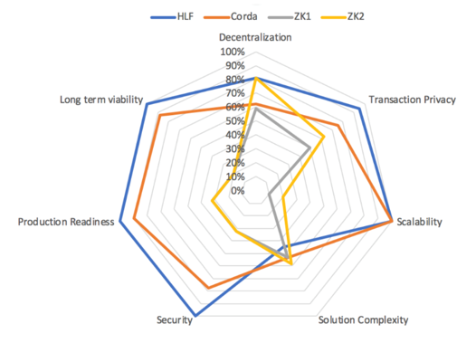
Hyperledger Fabric
HLF based solution was the only one that completely satisfied privacy and decentralization requirements of the POC.
Best all round rating across all dimensions considered.

Slide 12
Solution Overview
Privacy and Visibility
Two Tier Channel Structure

Slide 13
Overview-Architecture Views

Slide 14
Project Phases

Slide 15
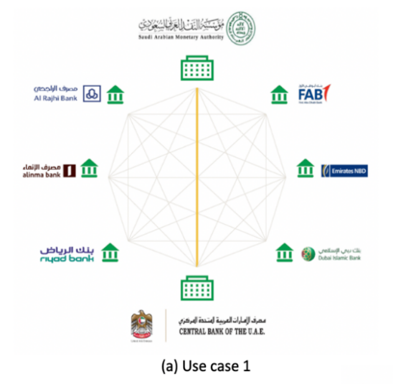


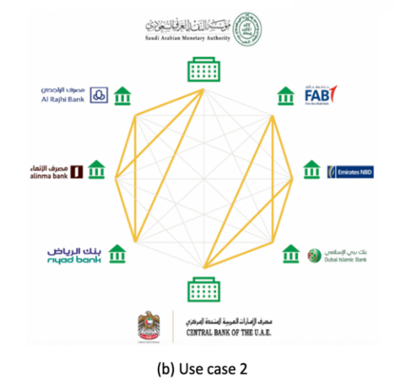

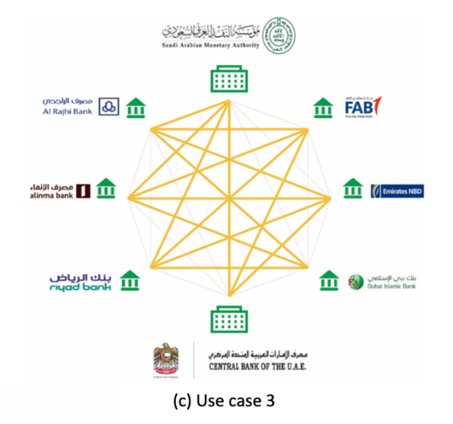
Project Phases
UC1: Transactions between central banks
UC2: Domestic transactions
UC3: Cross-boarder transactions

Slide 16
Project Result
The project demonstrated that distributed ledger technologies will contribute to providing central banks with the necessary capabilities to develop payment systems at the domestic level, as well as to facilitate cross-border payments.
The project achieved its key objectives of establishing the concept, the actual application of DLT and knowing the extent of their impact, and the participation of commercial banks in this process.
The results achieved by the project can be used to expand the scope of knowledge content and expertise in the use of blockchain and DLT in the projects that may follow.
In the event that a realistic application is desired to build a central bank digital currency project based on DLT, the economic impact needs to be examined extensively.

Slide 17
Challenges

Slide 18
Challenges
Business Challenges
Technical Challenges
Currency rate should be kept static for the POC.
The importance of setting restrictions that contribute to risk management and allow the use of real money.
Use of real money in the project while transactions are not real (simulation).
The need to discuss aspects related to economic impact, especially on monetary policy and financial stability, and this includes decisions related to monetary areas such as exchange rates and interest rates.
Compliance with IT security standards at all stages
Complexity related to Network Resiliency
Complexity associated with selecting various scenarios and mapping them to specific roles while maintaining segregation of duties
Cloud and on premise options and data privacy regulations across different jurisdictions.

Slide 19
THANK YOU.

