Slide 1


Digital Procurement Platform
December 08, 2022

Slide 2

Accelerating digital transformation of government procurement process
The Digital Procurement Platform (DPP) is a comprehensive system that digitalises the procurement process across the UAE federal entities.
Developed by the Ministry of Finance, which brings together the federal entities and registered suppliers on a single platform, and all the stages of the procurement process including announcement, bidding and following up on tenders, placing purchase orders, and generating invoices, can be completed online.
The platform is part of the UAE leadership’s vision to support the digital transformation of procurement across the federal entities.

Slide 3
Leading design principles have been leveraged to develop the digitally enabled modern procurement policy
Digital Adoption
New Procurement System shall be promoted within Procurement Organizational Unit and the wider Entity to drive innovation and improve efficiency
Insights Driven Decision Making
Procurement and Requesting Organizational Units shall make decisions based on access to high quality data and insights
Value Creation
Ethical Conduct
Work together with cross functional organizational unit stakeholders to generate maximum value for the Federal Entity
Operate with highest degree of integrity and ethical standards while conducting procurement processes
Ecosystem Collaboration
Strong collaboration of the Procurement and the Requesting Organizational Unit shall lead to unified goals and objectives
Operational Excellence
Streamlined processes and clear responsibilities shall be defined to ensure a compliant and process driven Entity

Slide 4

Key Enhancements in the Digital Procurement Policy
Online eAuction
Digitalization of Key Processes
Sustainable Procurement
Faster Process for
Supplier Onboarding
Modern & Futuristic Procurement Policy for the UAE Federal Government
SME Incentivization Program
Supplier Segmentation
ICV Framework
Category Management
in-line with leading practices
Friendly Supplier Guidelines

Slide 5





Key Objectives of the Digital Procurement Platform (DPP)
Provide a user-friendly experience
Easily accessible through a user- friendly interface
Speed up procurement process
from 60 days to 6 minutes
Introduce a new concept of government procurement by
Creating a catalogue of the commonly procured goods & services
Enhances the efficiency of government spending by
Signing Framework agreements with suppliers
Encourages participation of SMEs
SME support & Incentivization Program
Introduce Reporting feature (Dashboard)
Integrates all data related to procurement & supplier performance

Slide 6
Monitoring Mechanism and Governance for Federal Government Procurement
Digital Procurement Policy & Manual
Delegation of Authority (DoA)
Code of Ethics & Conduct
The policy sets out guidelines, protocols and standards for procurement processes across the Federal Entities.
A Delegation of Authority (DOA) document and/or matrix sets out delegated powers and authorities including the financial limits associated with it.
The policy sets out the Code of Ethics & Conduct for:
Federal Entities (Fairness, Integrity and Transparency, etc.)
Suppliers (Fraud, Bribery, etc.)
Procurement Governance
Supplier Relationship Management
Digital Tender Management
Setting out clearly defined roles & responsibilities for the different units/teams:
Centralized Procurement Unit (CPU)
Entity Requesting Organizational Unit (ROU)
Entity Procurement Organizational Unit (POU)
Entity Finance Organizational Unit (FOU)
Supplier Self-Registration
Supplier Qualification
Supplier Performance and Risk
Supplier Offboarding
RFx (RFI & RFP) on the platform
Bid Submission
Bids Evaluation
Negotiations & Award
Online eAuction
Supplier disqualification
Digital Awarding

Slide 7
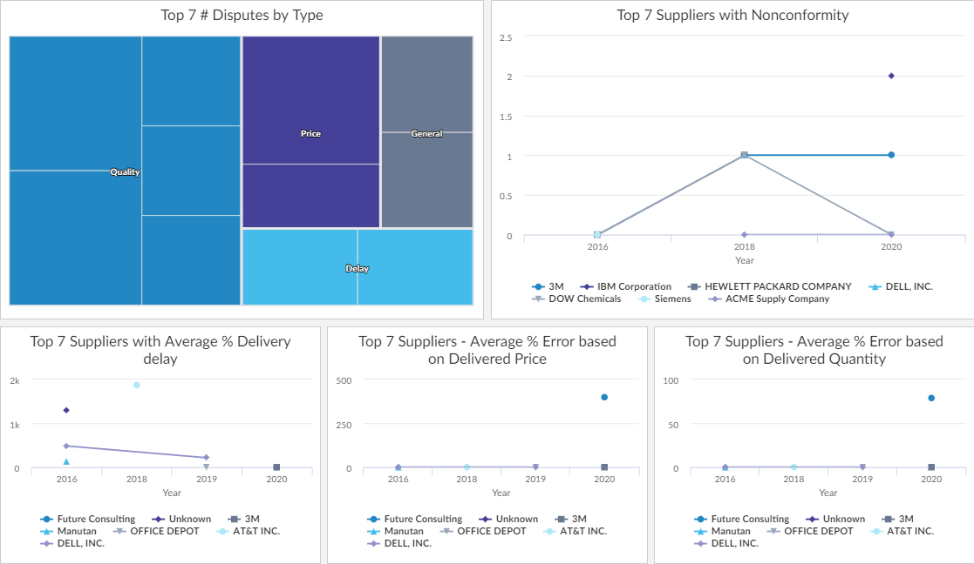
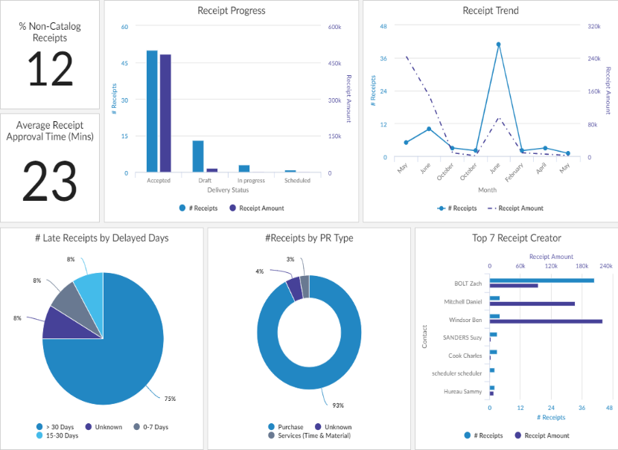
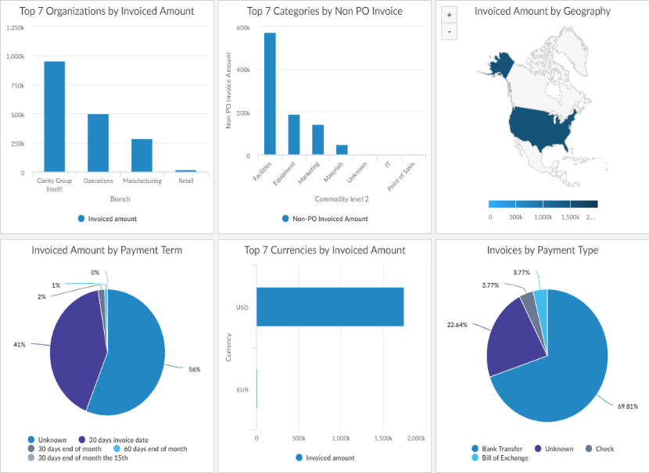
ADD BETTER SCREENSHOT
Advantage of Smart Monitoring (Dashboard)
Detailed Reports for Procurement Processes to ensure Transparency and Governance
Supplier Performance
Procurement Analysis
Invoice Analysis

Slide 8
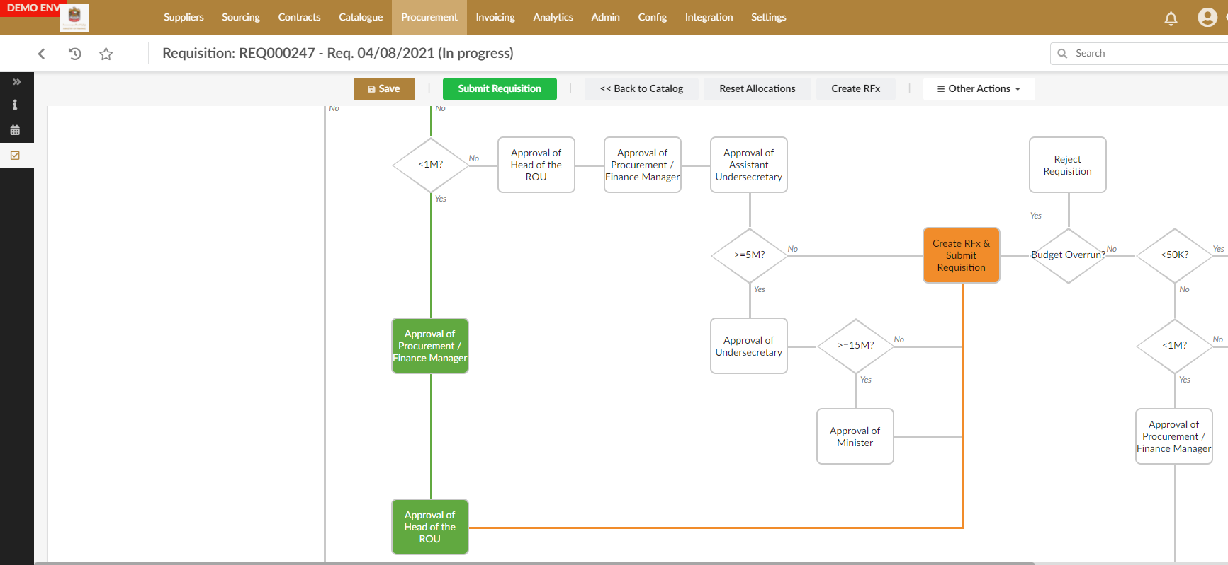
Process Automation using Workflows

Slide 9

Product Selection and Budget Control mechanism
One of the flagship feature of DPP is the ability to select product(s) from a catalogue where the price is pre-agreed through contractual negotiations with the vendor.
All the available items by the vendors are available through an interface similar to e-commerce applications.
The required level of approvals as per the Digital Procurement Policies and the Delegation of Authority are managed and controlled through the platform.
The Budget check also happens through the system through a direct integration with the Federal Financial System.

Slide 10
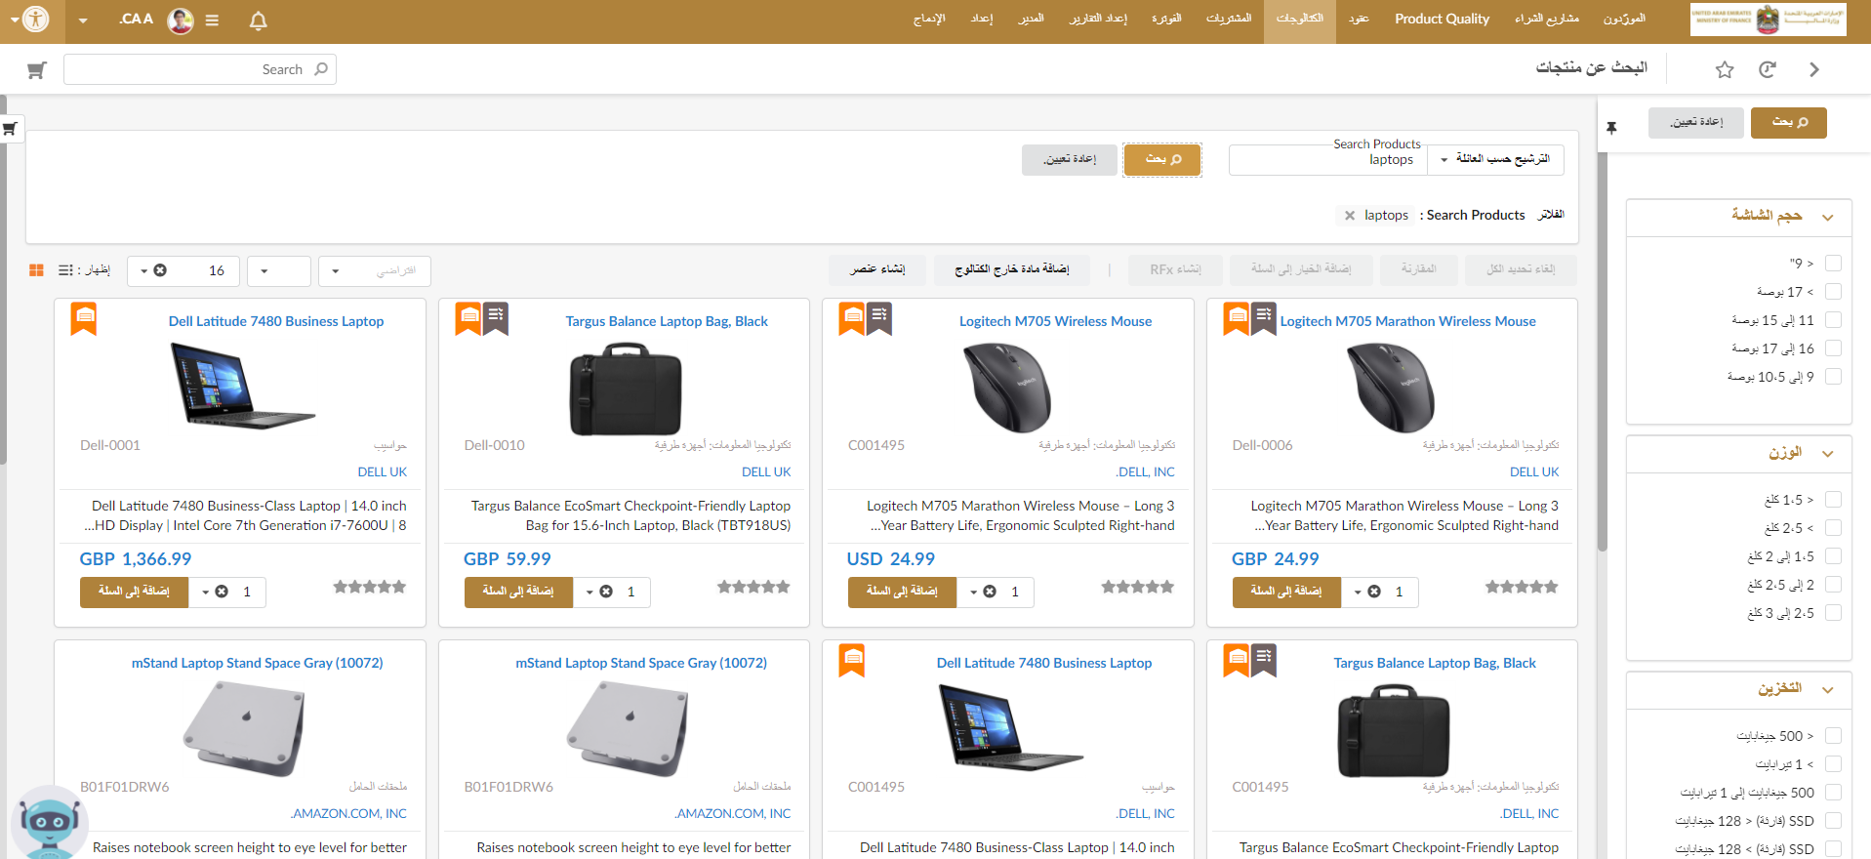
Product selection through catalogues

Slide 11
Budget control during the catalogue process
Start
Requestor browses the catalogue
Requestor selects items and adds to the cart
Requestor submits Requisition for approval
Budget check ok?
Approved?
Yes
Approver review and Approve PR
No
End
No
Yes
System rejects Requisition
PO is created and sent to Supplier by System
End
End

Slide 12
P2P Process Controls
User’s access to budget activities restricted
Budget controller check
Up to 5 levels of approval based on PR value
Auto-created from PR/Tender
PO Acceptance by Supplier
Additional approval if value different from PR
Technical Evaluation
Commercial Evaluation
ICV Evaluation
Purchase Requisition
Tender
Purchase Order
Payment created and transferred to TMS
Payment approval process based on signing limits within TMS
All payments based on P2P workflow through transfers via TMS only. Checks, Cash and manual payments are
disabled.
Supplier enters invoice against PO automatically through portal
Invoice undergoes approval process by Finance team
Invoice automatically transferred to FMIS for payment post approval
Receipt should match PO
Any difference triggers additional approval as per policy
Payment
Supplier Invoice
Receipt

Slide 13
Contracting Process and Control Mechanism
Start
Procurement Team selects Applicable Contract Type
Requesting Organization Approves Contract/Provides inputs
Contract is sent to Supplier for review
Any Changes?
Yes
Collaborate with entity to review and approve changes
Sign and share the contract (both parties)
No
Sign and share the contract (both parties)
End

Slide 14

Contracting Process and Control Mechanism
Once the supplier has been awarded, the Procurement Team works closely in collaboration with the Requesting and the Legal Team to create the contract and send it across to the awarded supplier(s) for signature. The supplier then signs the contract.
End-to-end process of creating the contract is done digitally, with all its inclusions, on the procurement system

Slide 15

Monitoring Through Reporting
The key Procure to Pay/Order to Cash process in DPP can be monitored through reports and dashboards which are inbuilt in the tool.
There are other reports which are configured in the system as per the requirements of the entities which are used to monitor effectively the process and performance of the procurement processes and activities.

Slide 16
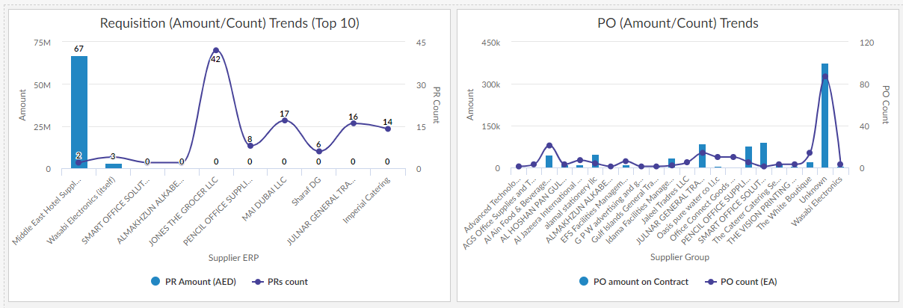
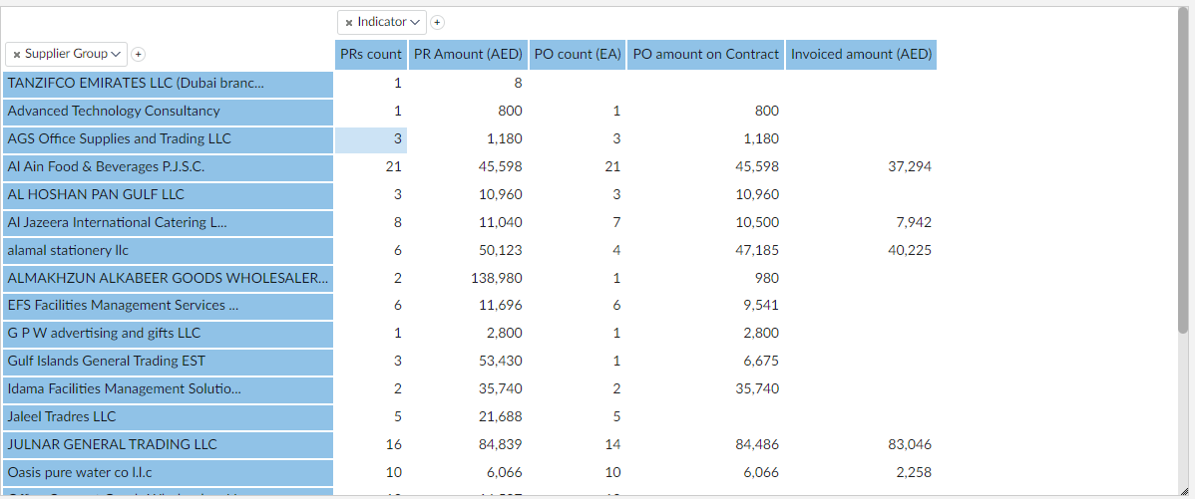
Monitoring through reporting Catalogue consumption report

Slide 17
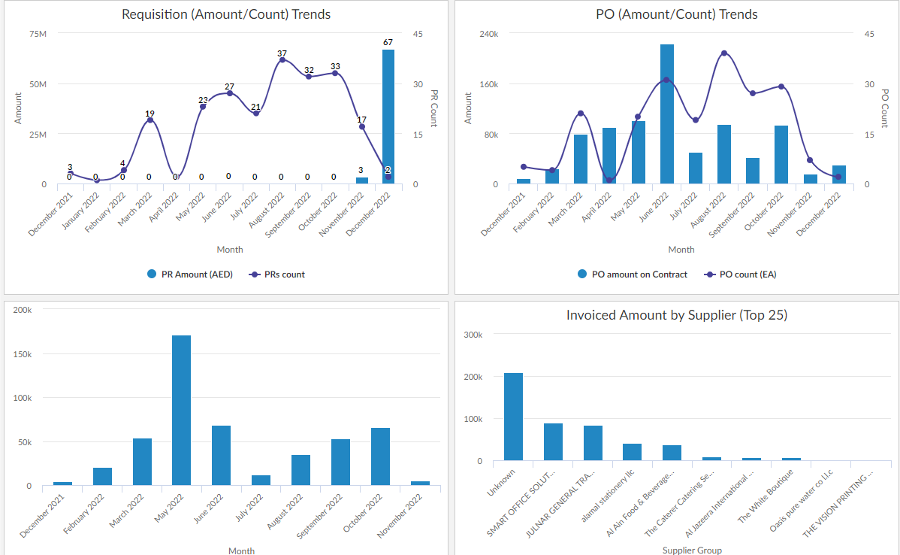
Monitoring through reporting: PR, PO and Invoices

Slide 18
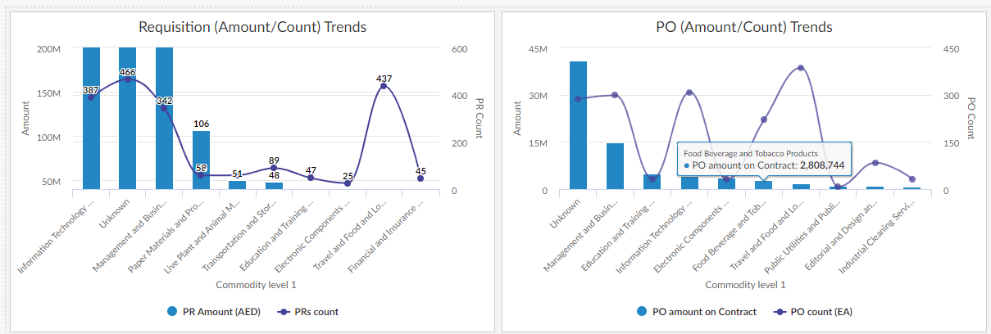
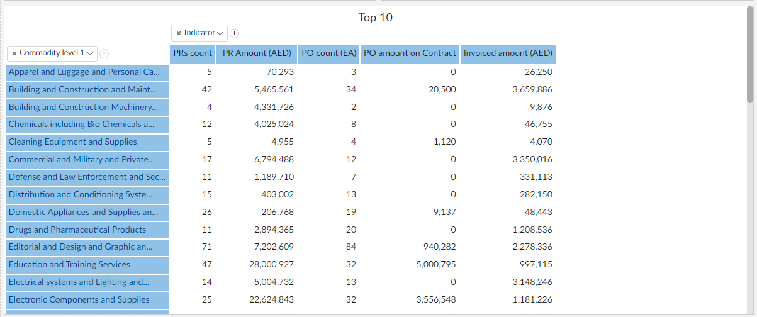
Monitoring through reporting: PR/POs by Suppliers

Slide 19
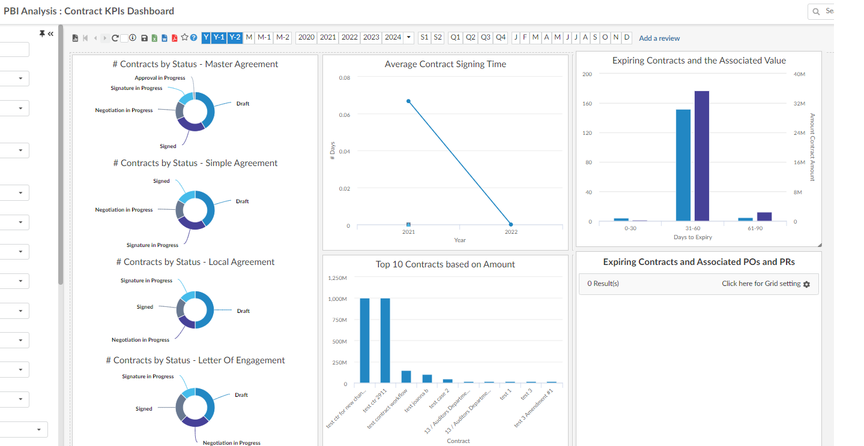
Monitoring through reporting: Contract KPIs

Slide 20





Thank you
www.mof.gov.ae
@MOFUAE

