Slide 1
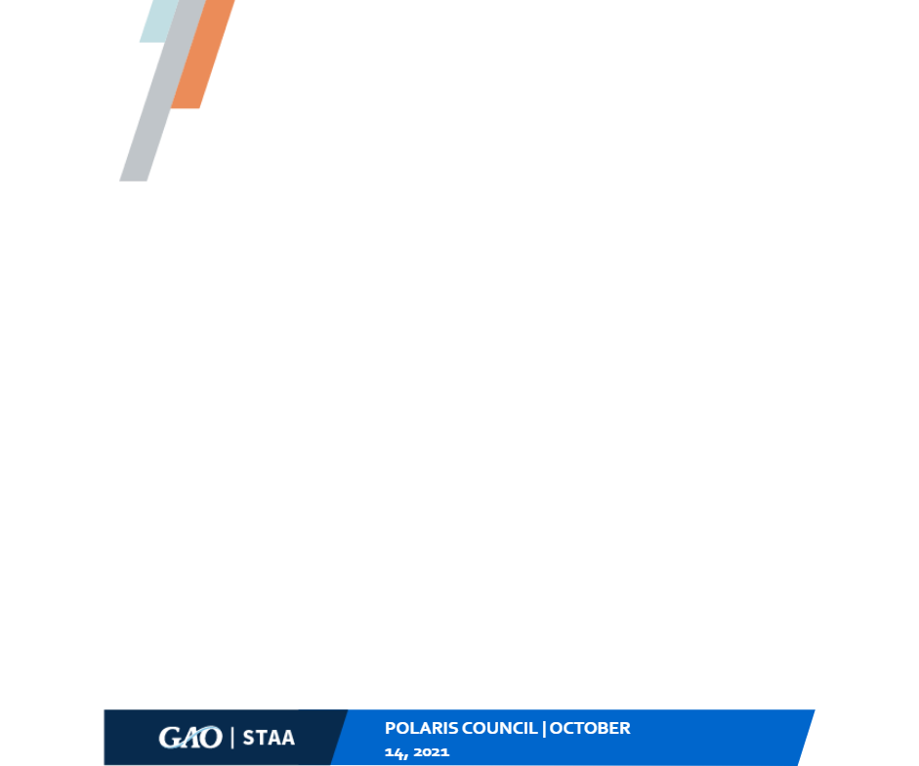
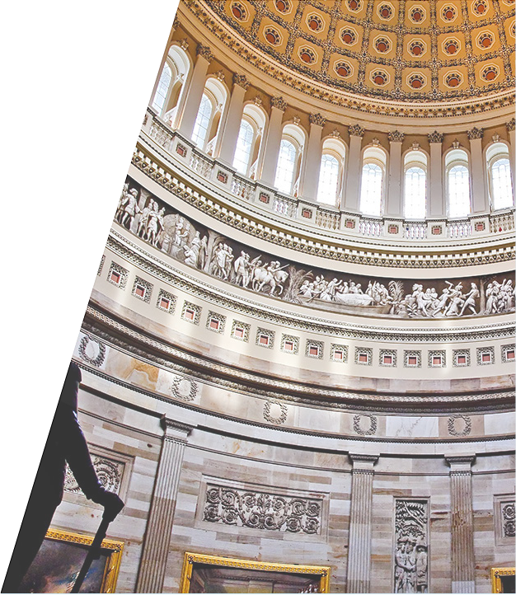


INTOSAI Working Group
Supporting the U.S. Congress on Emerging Science & Tech Issues
INTOSAI MEETING: DECEMBER 8, 2022

Slide 2


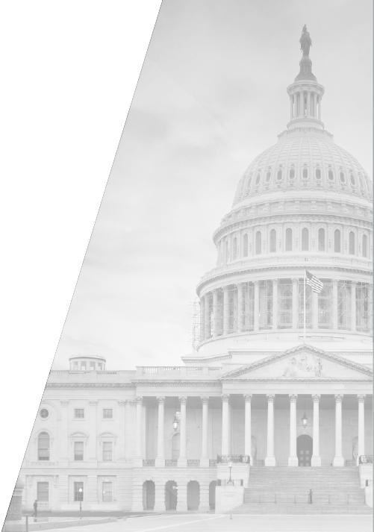


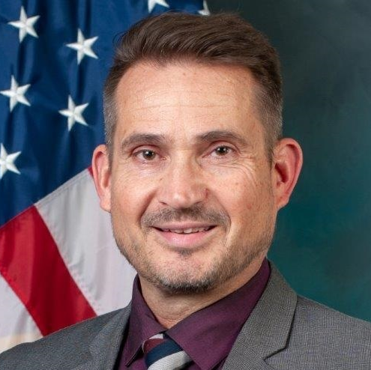


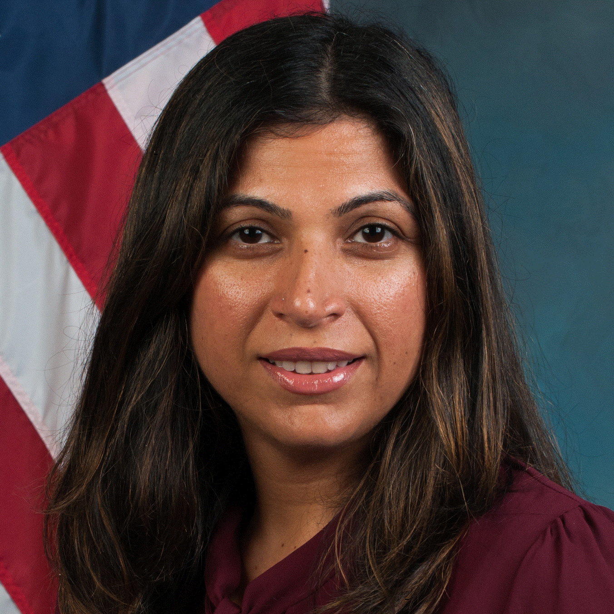
INTOSAI MEETING
DECEMBER 8, 2022
Today's speakers
John Neumann
Science, Technology Assessment, and Analytics Managing Director
Farahnaaz
Khakoo-Mausel, PhD
Science, Technology Assessment, and Analytics Assistant Director

Slide 3


ABOUT GAO
Who We Are
GAO is an independent, nonpartisan agency serving the Congress and helps improve the performance and ensure the accountability of the federal government
Core values: Accountability, Integrity, and Reliability
Often called the "Congressional Watchdog"
Oversight, Insight, Foresight

Slide 4

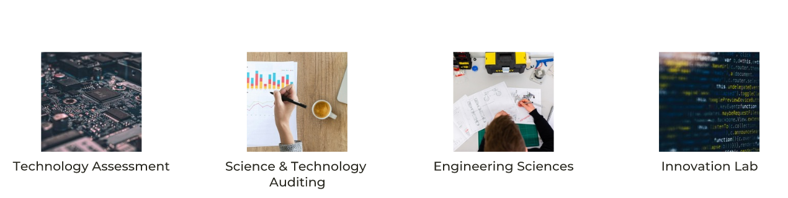

Who is STAA?
INTOSAI MEETING | DECEMBER 8, 2022

Slide 5
The Innovation Lab
Uses emerging technologies to explore and develop cutting-edge analytic, auditing, and cybersecurity solutions
INTOSAI MEETING | DECEMBER 8, 2022

Slide 6
Combining data science with digital delivery
Web-based Antifraud Resource
Built by the Lab and GAO's fraud experts in Jan. 2022 to help federal officials and the public better understand and combat fraud.
Uses Amazon Web Services (AWS) cloud platform to host the website.
Utilizes Lambda with Python, as well as Angular JS, among other services.
ID Verification Controls Simulator
Interactive web-based resource that helps federal agencies improve controls in their programs and prevent improper payments.
Built using the programming language Shiny (R), and deployed using AWS to enable scaling.
INTOSAI MEETING | DECEMBER 8, 2022

Slide 7
GAO's Internal Use of Technology
Congressional activity monitoring
Automated, web-based tool to monitor Congressional activity and link this activity to GAO products
Uses custom-built natural language processing models
Once fully operational, will enhance GAO's ability to meet Congressional informal needs
For example, tool has linked issues like digital ID verification, artificial intelligence, and location-based privacy protection to immediate Congressional needs
Could help inform nature & scope of potential future S&T-related work
INTOSAI MEETING | DECEMBER 8, 2022

Slide 8
Augmented Reality
Exploring use of augmented reality to enhance auditors' capabilities to gather, share, and display evidence
Project provides remote subject matter expert assistance to auditors during travel
Allows for active participation of remote or geographically dispersed staff
Provides novel display of information in 3D
Tool could facilitate knowledge transfer without travel risk or cost for additional personnel, allow remote staff to actively participate during site visits, and easily record and document walk-throughs
INTOSAI MEETING | DECEMBER 8, 2022

Slide 9
STAA's Interdisciplinary Support to Congress on AI Technology and Its Implications
AI Framework (GAO-21-519SP)
Digital Services Academy (GAO-22-105388)
INTOSAI MEETING | DECEMBER 8, 2022

Slide 10




What is the AI Accountability Framework?
Elements of the AI Accountability Framework
Governance:
Data:
Performing:
Monitoring:
Promote accountability by
establishing processes to
manage, operate, and oversee
implementation
Ensure quality, reliability, and
representativeness of data
sources and processing
Produce results that are
consistent with program
objectives
Ensure reliability and relevance
over time

Slide 11
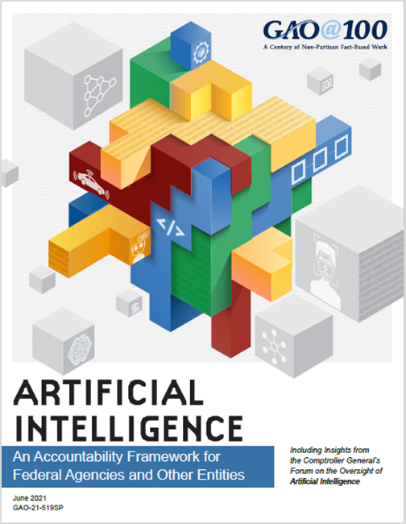
AI Accountability Framework
Providing oversight for AI systems
To help managers ensure accountability and responsible use of AI in government programs and processes, we developed a framework.
INTOSAI MEETING | DECEMBER 8, 2022

Slide 12
Audit of an AI System
Research objective: To what extent has the selected agency incorporated key practices identified in GAO's AI Framework?
Scope: Review 2-3 AI systems/applications within one selected federal agency (chosen based on prior GAO AI expert meetings).
INTOSAI MEETING | DECEMBER 8, 2022

Slide 13
Audit of an AI System, continued
Method: Determine the extent to which the selected agency incorporated a specific key practice:
For each system, we will apply 2-3 practices from each principle and associated audit procedure (key questions, audit method/procedure, and interview).
We will collect strategic implementation plans that describe the goals and objectives for the design, development, and deployment of each AI system. Collect data management plans and documentation--data provenance records, inventories, and dictionaries--that describe the sources and origins of data and technology used to collect the data; and review samples of data being used for training to assess whether they are accurate, complete, and valid.
Audit team: GAO's Innovation Lab (developers and data scientists), Audits Portfolio (auditors), and other relevant teams (domain expertise) as well as lawyers and methodologists.
INTOSAI MEETING | DECEMBER 8, 2022

Slide 14

INTOSAI MEETING
DECEMBER 8, 2022
Questions?
We look forward to seeing you soon. Thank you!

