Slide 1
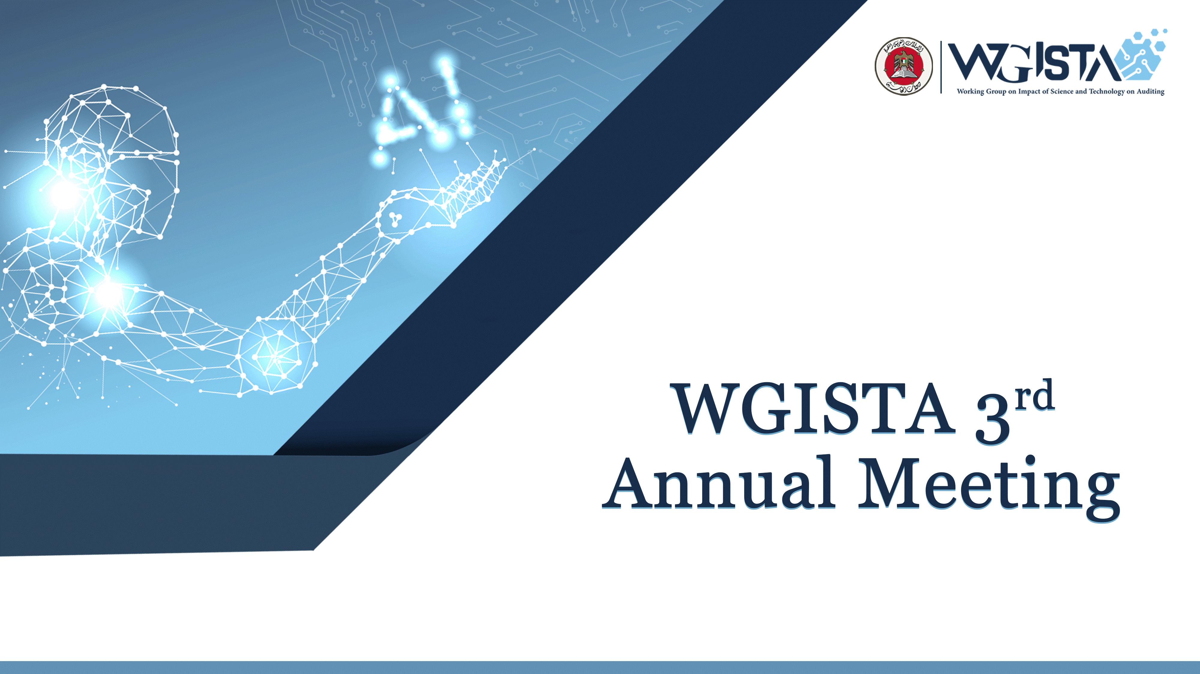

Slide 2


Environment Scanning Report
Project Updates
By Abdulla Alshehhi (SAI UAE)
John Neumann (GAO, USA)
Date: Dec 7th, 2022

Slide 3
Scheme of Presentation
Introduction of Project
Literature Review
Environment Scanning Survey
Expert Interviews
Future Outlook

Slide 4
Introduction of Project
Approved as First WGISTA project in 1st Annual Meeting 2020
Project Team
  The project team includes WGISTA Secretariat and GAO
The scope of the project included:
  Literature Review
  Environment Scanning Survey
  Expert Interviews

Slide 5
Need for Environment Scanning – Emerging Technologies Benefits
Full coverage of data
More efficient audit processes
Continuous auditing
More reliable audit evidence
Better understanding of the client systems
Improved risk assessment of client
Intelligent document analysis
Identify outliers and errors in data
Review of unstructured data

Slide 6
Literature Review

Slide 7

Review of Literature on Auditability of Emerging Technologies
U.S. Government Accountability Office (GAO) Science, Technology Assessment, and Analytics
WGISTA Annual Meeting October 2021

Slide 8

Policies and Regulations
Artificial intelligence. Governments have introduced policies to better regulate and incentivize the use of AI systems.
Robotic process automation. There is a lack of guidance on how to implement RPA.
5G networks. Policies and regulations do not ensure equitable access, nor do they prioritize standardized practices in managing 5G.
Blockchain technology. Governments are focused primarily on regulating cryptocurrency and related aspects of blockchain technology.
Quantum computing. Quantum computing is not fully mature and policy considerations should focus on establishing and promoting a workforce that can further develop the technology.

Slide 9

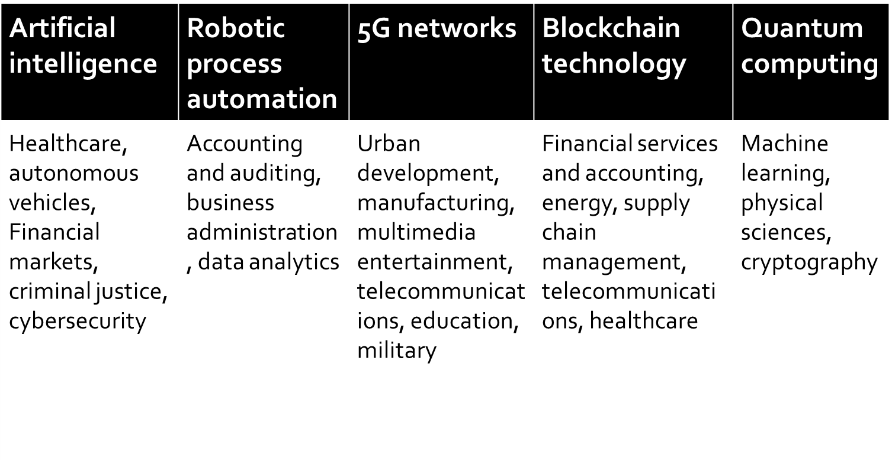
Sectors

Slide 10

Workforce Skillsets
Artificial intelligence. Auditors should have an understanding of the different types of AI methods.
Robotic process automation. Auditors should be able to understand how RPAs are programmed and may also employ RPA to increase efficiency in audits, and reduce costs.
5G networks. Auditors need the skills to understand how 5G networks operate, including how spectrums are allocated and distributed for public and private use.
Blockchain technology. Auditors are expected to focus on more complex analysis, such as systemic evaluation, risk assessment, predictive audits, and fraud detection.
Quantum computing. Auditors need an understanding of both quantum computing and the context in which the technology is used.

Slide 11
Environment Scanning Survey

Slide 12
Introduction
* One of the Research tools for Environment Scanning Project of WGISTA
* Other two research tools are:
* Environment Scanning Questionnaire was sent to all SAIs members of INTOSAI
* Received 47 responses
Expert Interviews
Literature Review

Slide 13
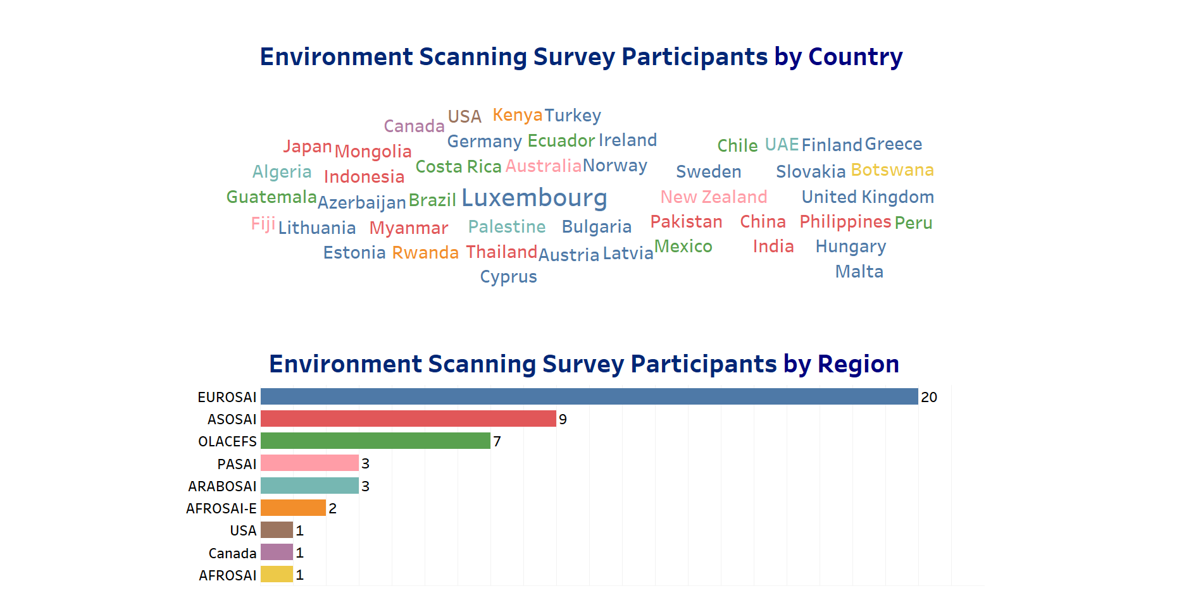
Responses Analysis

Slide 14
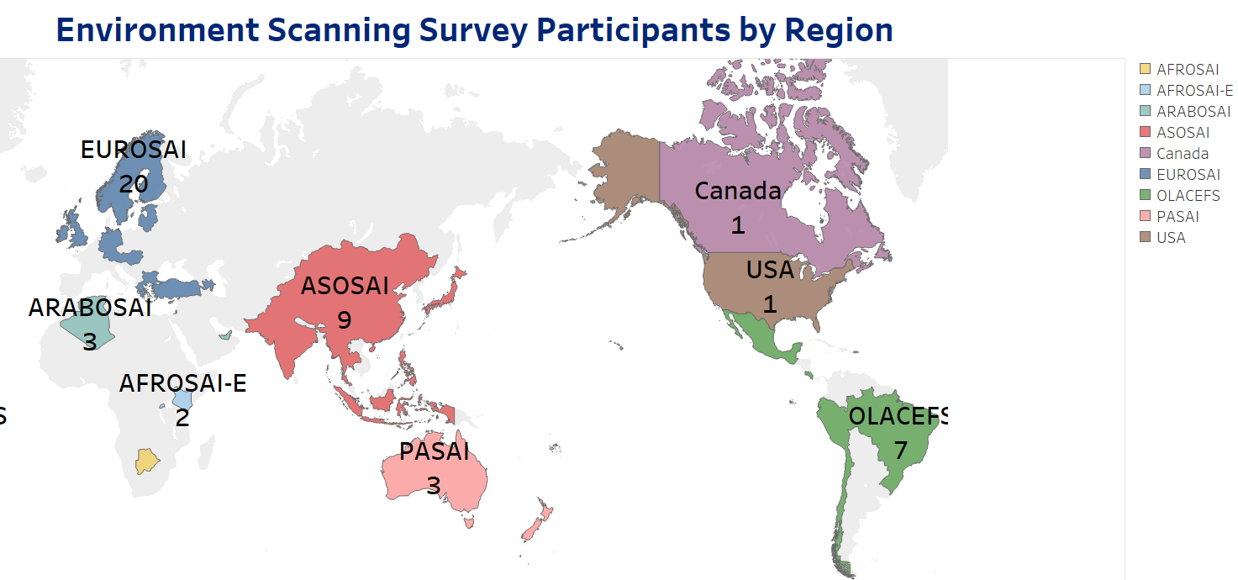
Responses Analysis

Slide 15
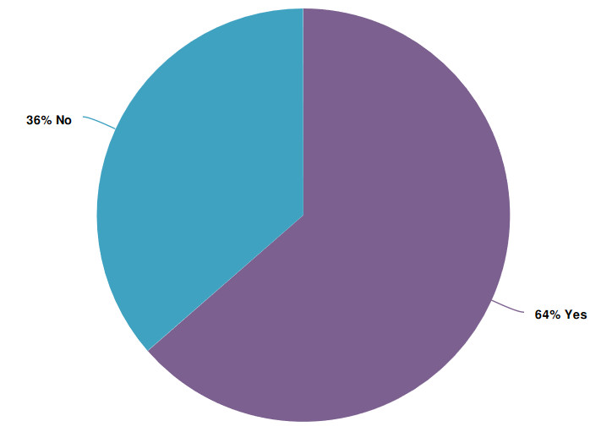
Responses Analysis
Separate IS Audit Department

Slide 16
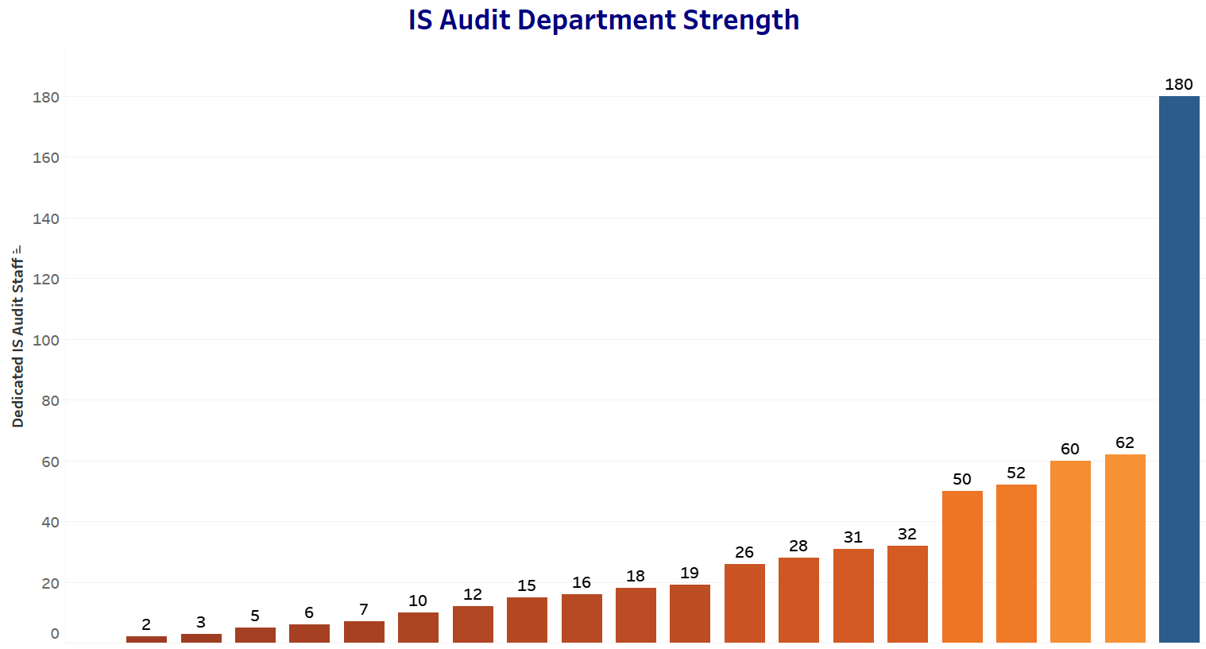
Responses Analysis

Slide 17
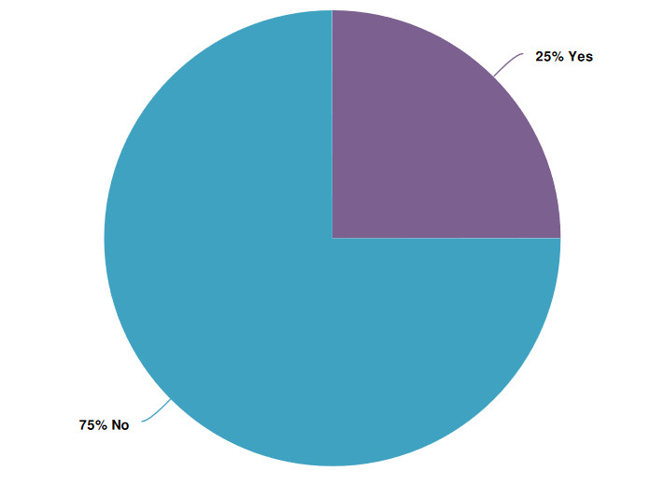
Responses Analysis
Separate S&T Department

Slide 18
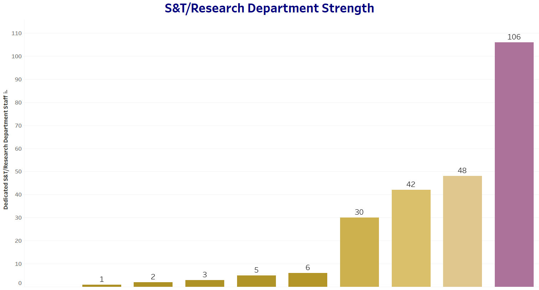
Responses Analysis

Slide 19
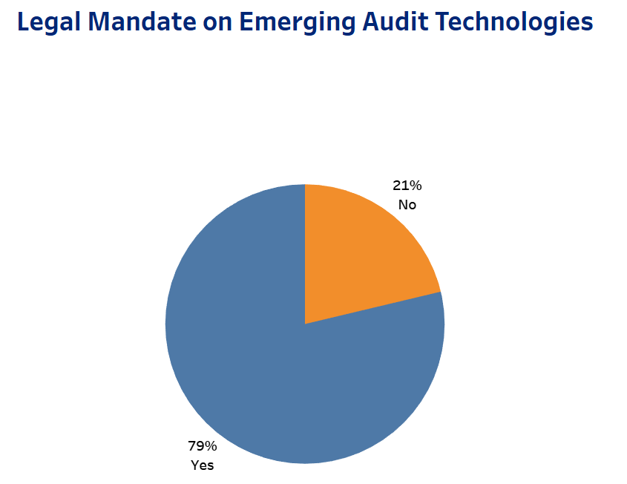
Responses Analysis

Slide 20


Responses Analysis
Legal Mandate on Auditing Emerging Technologies
Mandate exists
Explicit Mandate
Mandate exists but facing challenges
Explicit mandate but no challenges faced

Slide 21
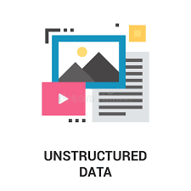


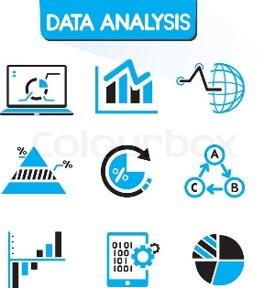
Responses Analysis
Challenges Using Conventional Technologies
Big data/large volume of data
Unstructured data
AI, Machine Learning, NLP, Computer Vision
Real-Time Data Analytics Audit
Robotic Process Automation
Data Visualization

Slide 22
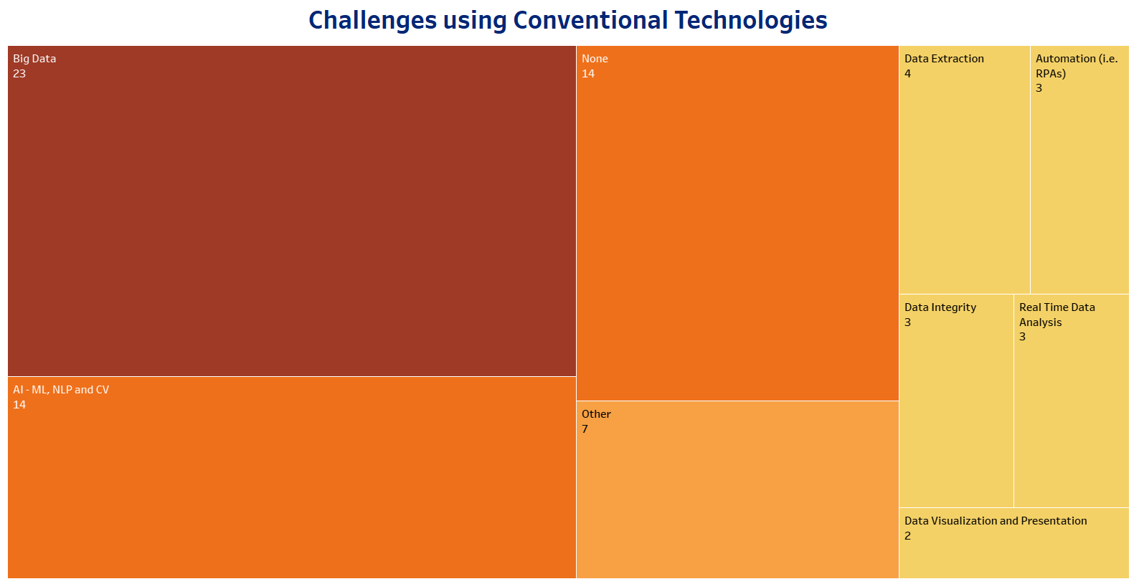
Responses Analysis

Slide 23
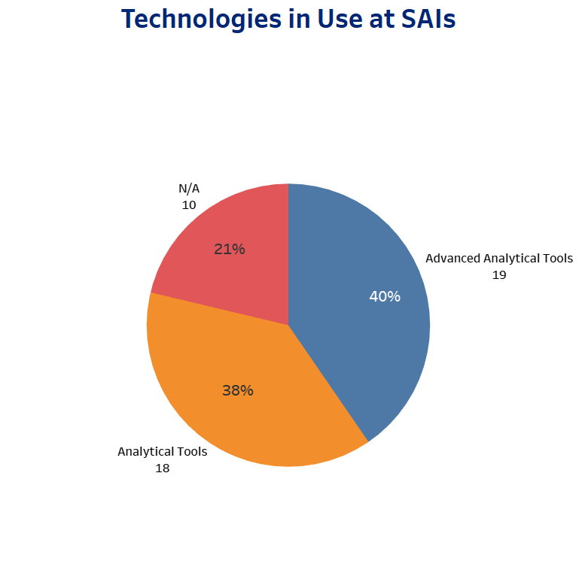
Responses Analysis

Slide 24
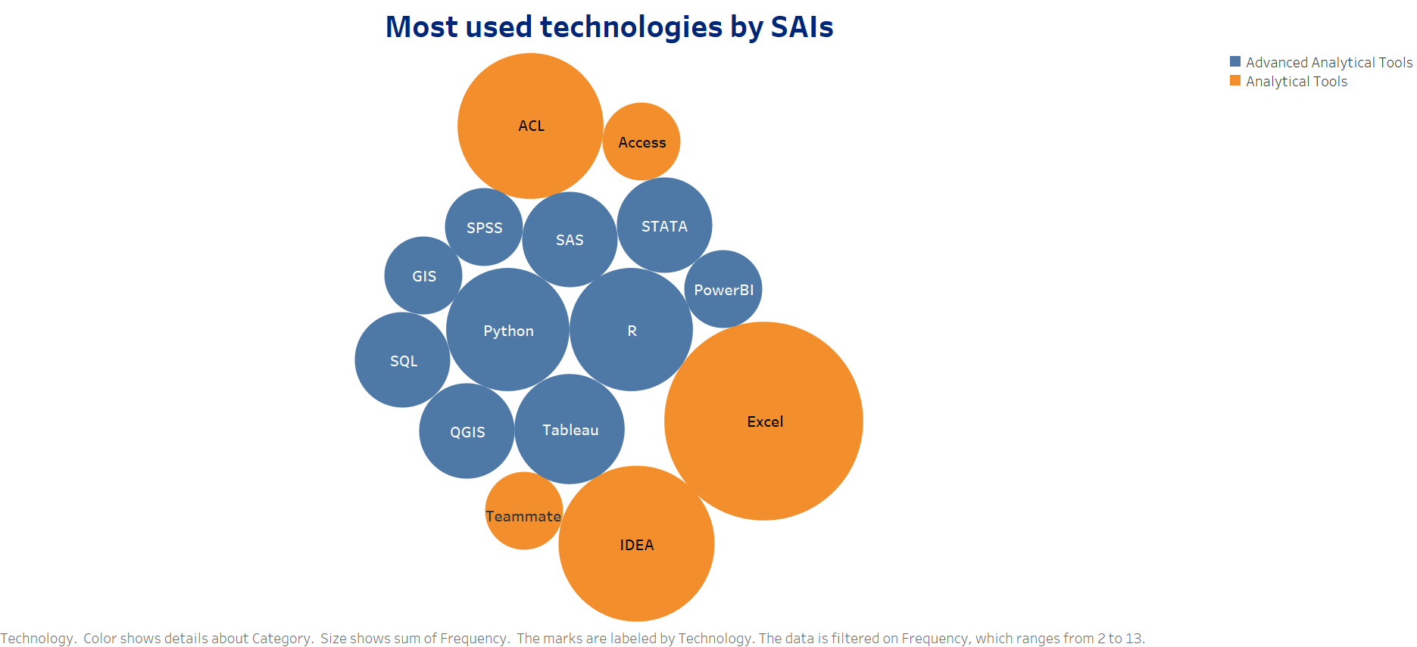
Responses Analysis

Slide 25
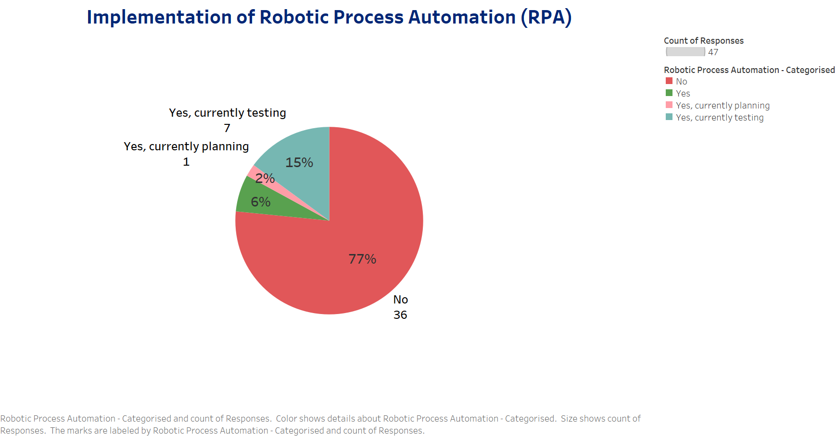
Responses Analysis

Slide 26
Implementation of Robotic Process
Automation
Pilot stage
Trying to use ACL for RPA, facing challenges
Small experiments with UI Path
No, But have interest
Exploring for Journal Entry Testing, Data Cleaning, Data Quality Assurance

Slide 27
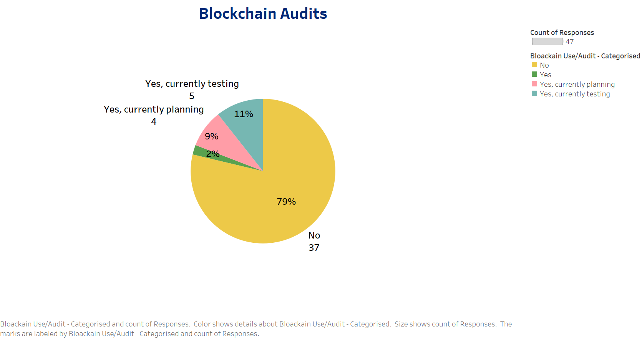
Responses Analysis

Slide 28
Responses Analysis
Planned in Government but not in SAI
In Asset Control for Registration of Cryptocurrencies
Auditors have received training on Blockchain
Planning in next few years
See limited use in Government. No plans at Audit Office
Used in Government but audited by specialized vendors and not SAIs
Planning Use Case to understand Impact and Cybersecurity Implications
Used as a pilot in Public Sector for Purchase Orders. Not used in Audit Office
Decentralized Digital Evidence Use Case

Slide 29
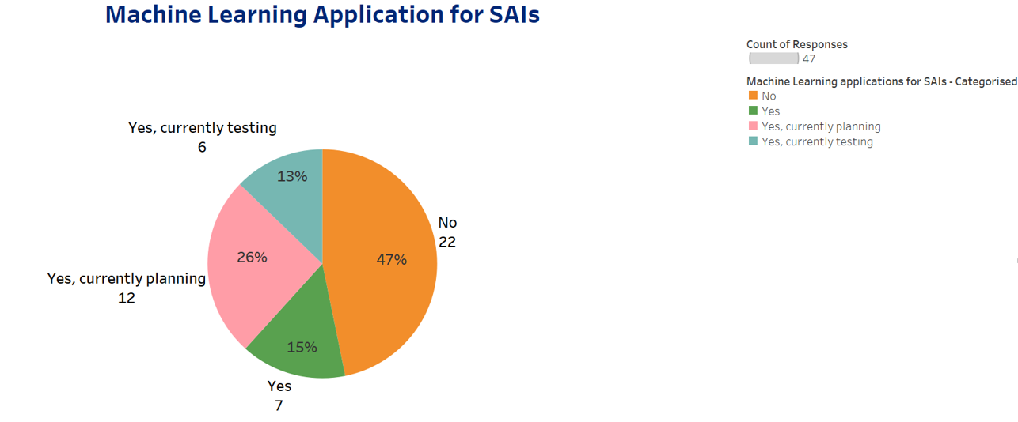
Responses Analysis

Slide 30
Machine Learning Applications for SAIs
Natural Language Processing
Outliers identification using Clustering Analysis
Fraud Detection, Parsing of Invoices
Risk Assessment
Regulator doesn’t support ML due to lack of evidence of repeatability of output
May help reduce capability gaps between senior and junior auditors
Topic Modeling, Semantic Analysis, Evaluating tones and writing styles
Named Entity recognition and relationships between documents of procurement

Slide 31
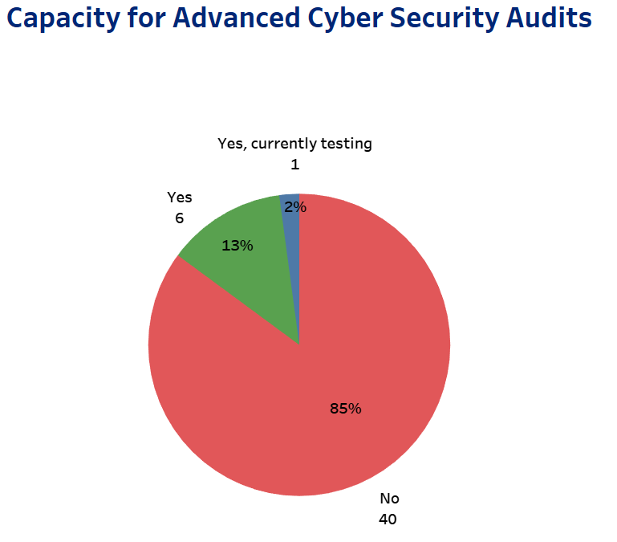
Responses Analysis

Slide 32
Capacity for Advanced Cyber Security Audits
Specialized Government Agency Responsible for these
Independent professionals hired for such audits
Auditee resist advanced cybersecurity audits
No need for advanced audits because of obvious/elementary mistakes we find
External agency does that but SAI reviews the scope, coverage and periodicity of such audits
SAI does Penetration testing, code injection tests etc

Slide 33
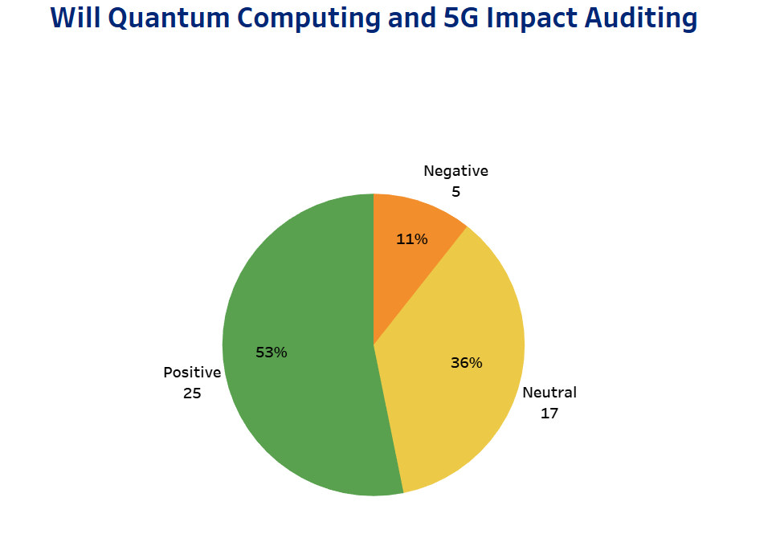
Responses Analysis

Slide 34
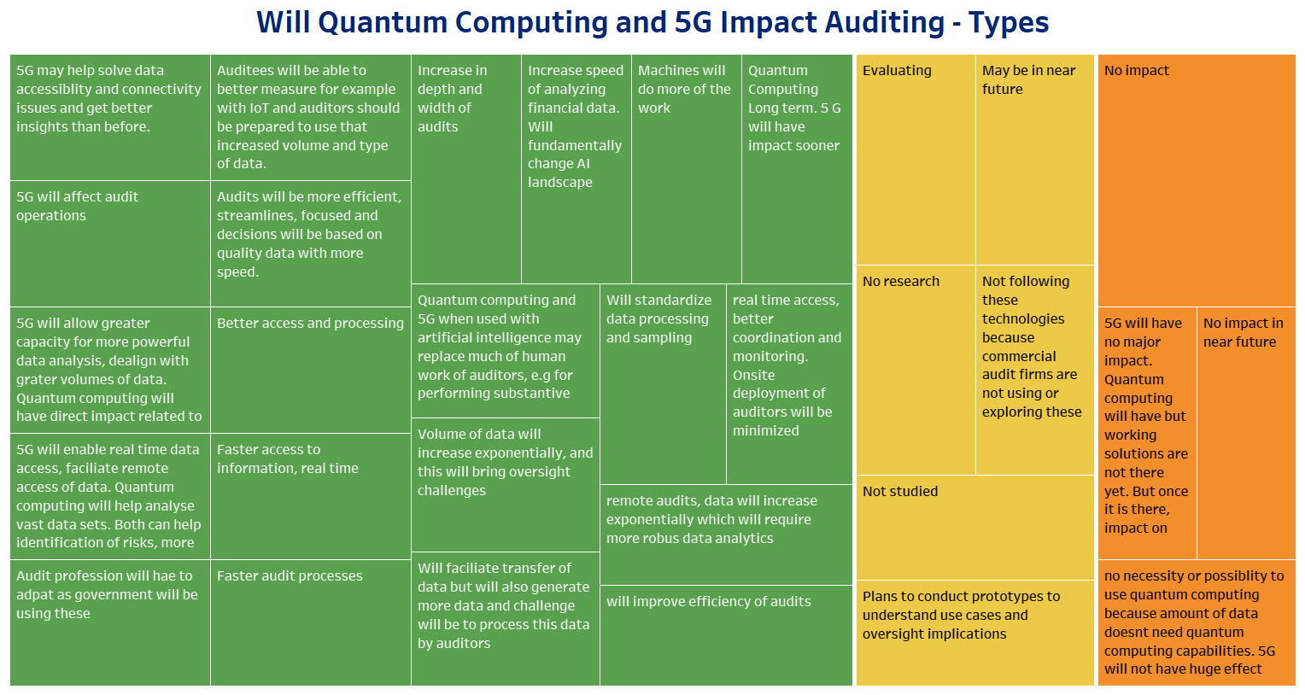
Responses Analysis

Slide 35
Expert Interviews

Slide 36
Experts Interviewed
Dr. Daniel Ho, Associate Director, Stanford Institute for Human-Centered Artificial Intelligence, Stanford University, USA
Dr. Khem Emrith, Head of Industrial Engagement, Mohammed bin Zayed University of Artificial Intelligence, UAE
Dr. Abdelrahman AlMahmoud, Principal Big Data and Analytics Researcher, Technology Innovation Institute, UAE
Mr. Musab AlHammadi, Project Manager, Artificial Intelligence, Digital Economy and Remote Work Applications Office (UAE)
Dr. Emin Gun Sirer, Associate Professor and Co-Director, Initiative for Cryptocurrencies and Smart Contracts, Cornell University, USA

Slide 37
Blockchain Maturity
Potential to disrupt governmental processes due to the benefits of transparency and auditability.
Blockchain technologies ready for mainstream government applications.
The latest generation of Blockchain-based systems, such as Avalanche and Solana, offer ease of implementation, cost, security, scalability and user experience

Slide 38
Blockchain Government Applications
Management and distribution of government benefits
Improve accounting practices, augment transparency in government bids, and automate polling and opinion collection in local governments, among other uses.
Document verification, identification, and evidence preservation.

Slide 39
Blockchain Adoption Challenges
Benchmarks are not well-established,
Terms are not defined clearly,
lot of misinformation
Difficult to identify developers
Difficult to ensure the correctness of Dapps (distributed applications built on Blockchains).

Slide 40
Artificial Intelligence Maturity
Matured significantly over the past 10 years.
AI-assisted auditing can address limitations of resource constraints.
Mainstream adoption remains a challenge.
The legal and regulatory environment, as well as leadership, hiring, and training issues

Slide 41
Artificial Intelligence Applications
(Related to Auditing)
AI-based audits or “algorithmic audits” can enhance and supplement traditional audit process.
The government needs to explain and justify their use of algorithms as well as related design decisions and the overall impact of the AI-based systems on the public.
The government needs to overcome institutional tendencies to use “black box” methods, which involve testing or deployment of AI without clear understanding of how an algorithm arrives at its predictions.

Slide 42
Challenges of AI Audits
The standards and scope of an “algorithmic audit” may be unclear
Audit targets could outright ignore or overlook audit result or use their knowledge to manipulate audit findings.
The identification of audit targets and scope may be uncertain.
Potential conflicts of interest
Rubber stamping practices
Hard to identify audit targets in the first place.

Slide 43
Best Approaches to Review AI Powered Systems
Setting performance guarantees
Utilize synthetic data to test the systems against changing environments and multiple scenarios
Proper testing using dataset that is representative of all (or most) of the data that the model will be exposed to in production.
The performance metrics used in training the AI model and the precautions taken to ensure service quality.
Review and analyze the training Datasets
Monitoring mechanisms to flag any potential performance degradation

Slide 44
Preparing and Training for Artificial Intelligence Era
Micro-degrees
Quality training programs which could be composed of multiple micro-degree-based ones or
Choose long structured trainings.
Customized training objectives to the specific challenges and tools used in the organization

Slide 45
Preparing and Training for Artificial Intelligence Era
Senior Management/Executives would need to know how AI systems can help improve performance and cut cost. So, AI training for leadership & change management is key.
Training should be provided for operational staff to understand the technical/functional aspect of AI-based systems.
Organizations must ensure that their employees are aware of:
  The applications (current and potential) of AI in their industry → All employees
  A general understanding of how AI models operate → some employees in every department
  A deep understanding of AI models → Employees in the technical teams

Slide 46
Strategic Investments SAIs Could Consider
Recruit AI experts because it’s not an easy skill to pick up.
Re-skilling/up-skilling employees
Purchase of new and emerging technologies.
Significant investment would go into the development/customization of products, their integration and testing
Strategically, organizations should aim to become AI-First organizations

Slide 47
Potential Areas of Interest for WGISTA
Publishing detailed and educative series of guides/white papers from SAI’s perspective on emerging technologies.
WGISTA can undertake projects to write guidance frameworks on these emerging technologies from an auditor’s perspective, especially focusing on auditability, risks, and controls.
Creating an experts group of SAIs
WGISTA may consider creating an INTOSAI innovation lab
MoUs with stakeholders
publish biannually a State of Emerging Technologies Report for SAIs.
Series of webinars

Slide 48
Next Steps
Sharing of Draft Report for comments of WGISTA members – 15-12-2022
Receiving feedback till – 31-01-2023
Improving report based on feedback received from WGISTA members- 28-03-2023
Publishing Environment Scanning Report -30-04-2023

Slide 49


