Slide 1


Embracing the
EXTRA-ordinary
Through technology
7 & 8 December 2022

Slide 2



OUR
MISSION
OUR
VISION
OUR
VISION
We have a constitutional mandate and, as the supreme audit institution of South Africa, exist to strengthen our country’s democracy by enabling oversight, accountability and governance in the public sector through auditing, thereby building public confidence.
To be recognised by all our stakeholders as a relevant supreme audit institution that enhances public sector accountability.

Slide 3
CONTENT
Enterprise Digital Transformation Strategy for SAI South Africa
Digitisation strategy
Digital initiatives
Automation of ITGCs
Successes and challenges
ISA Value Proposition

Slide 4
ENTERPRISE DIGITAL TRANSFORMATION STRATEGY
Our DX journey is at its infancy. It is based on 4 pillars.
1
2
3
4
Strengthen the Core Of Our Operations.
Improve User and Citizen Experience
Build a Data Driven Business
Automate Manual Processes
These are supported by fit-for-purpose governance processes, building an agile project delivery machinery, having appropriately skilled and engaged people, driving a culture of innovation, and having focused change management

Slide 5

ENTERPRISE DIGITAL TRANSFORMATION STRATEGY
High level views of DX initiatives
1
Strengthen the Core of Operations
Focus on Cyber Security and internal controls
Cloud Migration
Refresh tech assets
Replatform the business (Audit Software)
Digitise support functions (ERP)
4
Intelligent Automation
Strengthen the Core of Operations
Intelligent Automation
Implement Robotics Process Automation (blueprism)
Introduce AI and ML over time
5
Governance and Agility
Strategic approach to innovation
Revamp procurement processes for agility
All initiatives to be business case driven
Have agility in running projects
#ProgressOverPerfection
User and Citizen Experience
DX Pillars and Governance
Governance
2
Improve User and Citizen Experience
Rebuild our website
Build an interactive interface for reports to the public and stakeholders
Automate data interchange with auditees
Data Driven Business
People and Change Management
3
Build a Data Driven Business
6
People and Change Management
Build data lake/data warehouse capabilities
Implement data and analytics capabilities
Improve executive reporting
Upskill staff to improve Digital IQ
Have a focused change management programme

Slide 6
OUR INFORMATION SECURITY AUDIT BUSINESS
The DX strategy, plans and roadmap are long term in nature
To satisfy business demand, we focus on Innovation Sprints and running Proof of Concepts/Value
We build business capabilities in parallel to building IT capabilities
Our Information Security Audit (ISA) business is a case in point…

Slide 7
ISA VALUE PROPOSITION
Leveraging tech and data at auditees with complex business processes that process high volume transactions
Create centres of excellence for specialist areas and empower RA to perform routine procedures
Value enablement
Evaluating and providing opinions on the value for money government is receiving from spending on key IT projects and licenses
Driving the process of continuous auditing which will allow relevant and insightful messaging as well as partnering with our auditees to drive change

Slide 8
OBJECTIVES OF ISA’s DIGITALISATION STRATEGY
Increase Efficiencies
Reduce manual / timely processes
1
6
Focus on what matters
Become an agile workforce
2
7
Identification of new risks
Lead the auditors of future
3
8
Improve audit delivery timelines
Enhance what we do
4
9
Improve service delivery
Reduce audit costs (long term)
5
10

Slide 9
DIGITAL INITITATIVES
ISA DIGITAL TRANSFORMATION
DATA
ERP APPLICATION CONTROLS
GENERAL
CONTROLS
Data Analytics
Data Visualisation
SAP Audit Tool
Oracle/JDE
Audit Tool
ITGC Audit Tool
Contract / Doc.
Review Tool
CYBER SECURITY
Continuous
Automation
UAM
PCM
SM
Contracts
Policies
Procedures

Slide 10

ROBOTICS
  Success is easy to achieve once you set your mind on a specific goal - Aristotle

Slide 11
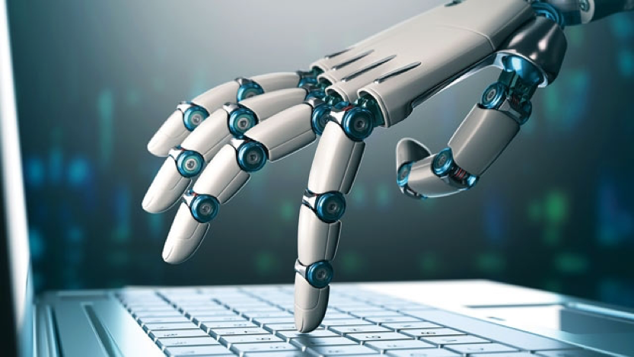
AUTOMATION OF ITGCS – FREE POC
Risk Assessment
Controls Testing
Completing the understanding of IT in accordance with he ISA315 standard.
Questionnaire driven with a simple set of questions to understand the design of the general IT controls (GITC’s).
Two overall deliverables
  Understanding of IT document containing all controls and their design details captured.
  IT scoping letter, detailing the scope of the audit for the IT team.
Completing testing on ITGC’s on the full population and no longer limiting testing to a sample.
Very limited time is required by the IT analyst once the evidence is uploaded to the tool and all tests can
Automatic working paper generation with conclusions that would just need the IT analyst to confirm and finalise.
B-ITGC

Slide 12
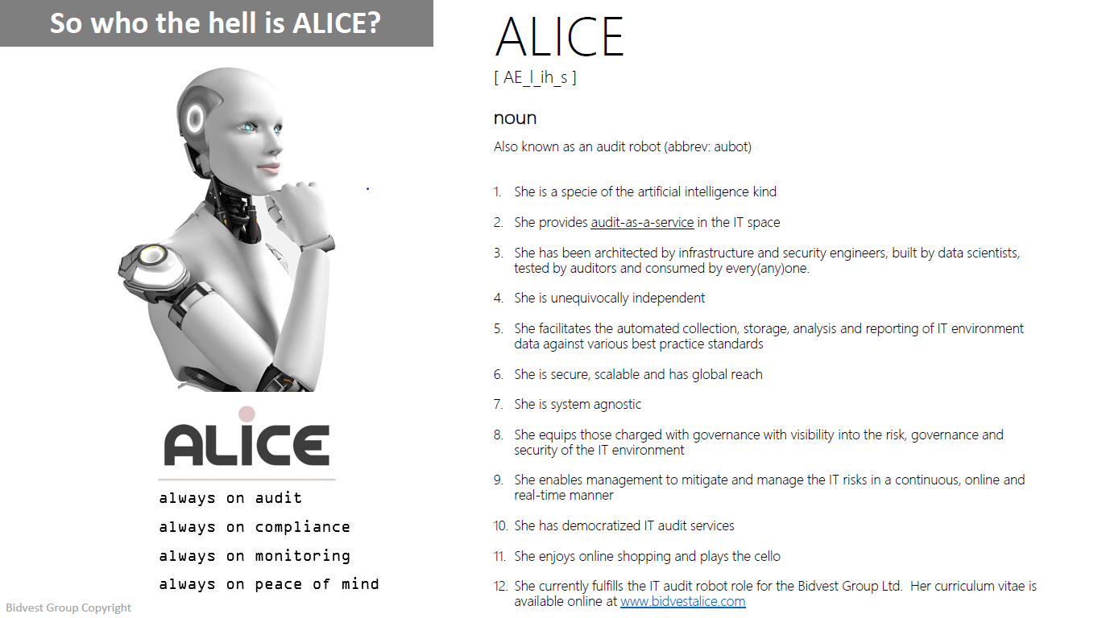
WHAT ROBOT DID WE USE?

Slide 13
CHALLENGES/CONSIDERATIONS
218 PFMA Auditees
79 MFMA Auditees
185 staff complement
41 Vacancies
Various IT Landscapes, complexities, posture, maturity
Technical skills and competencies limited
No common infrastructure, old systems
Lack of audit tools

Slide 14
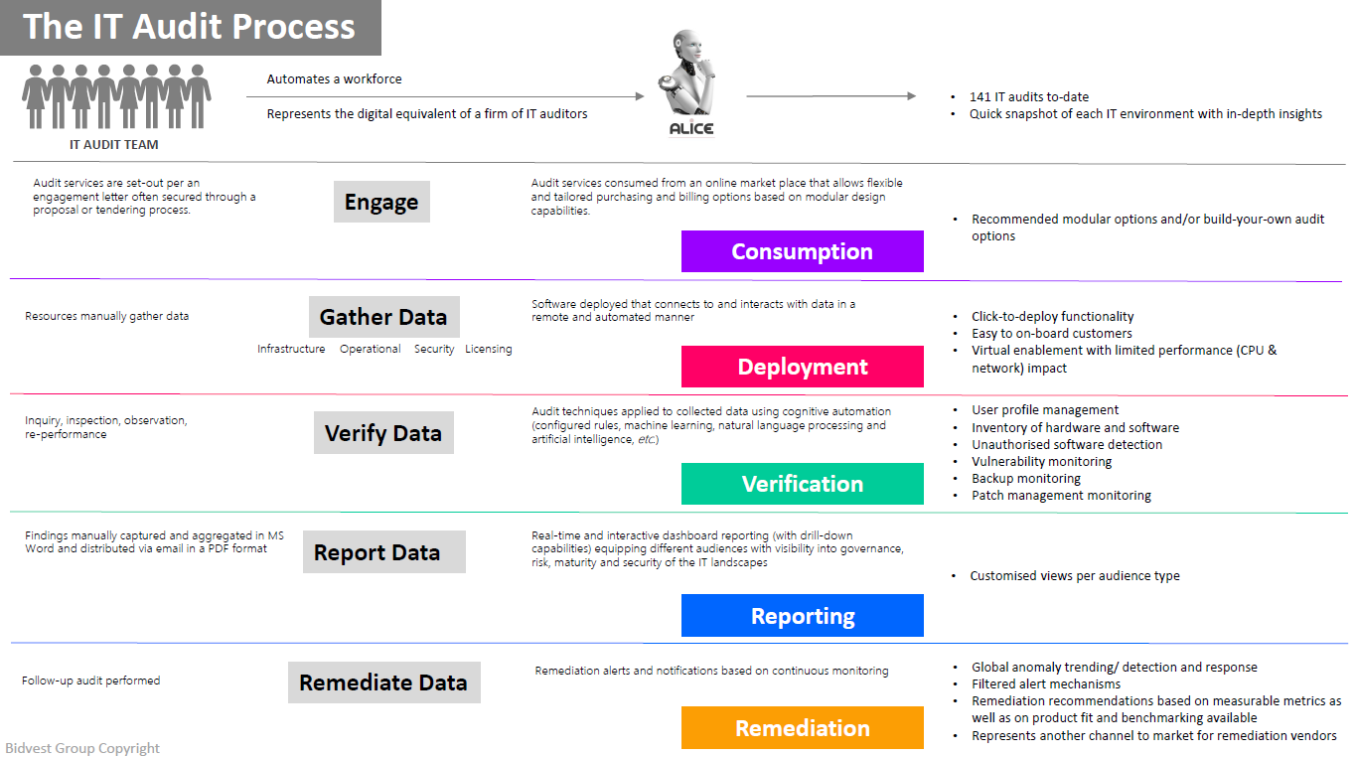
HOW DID ALICE DO IT?

Slide 15
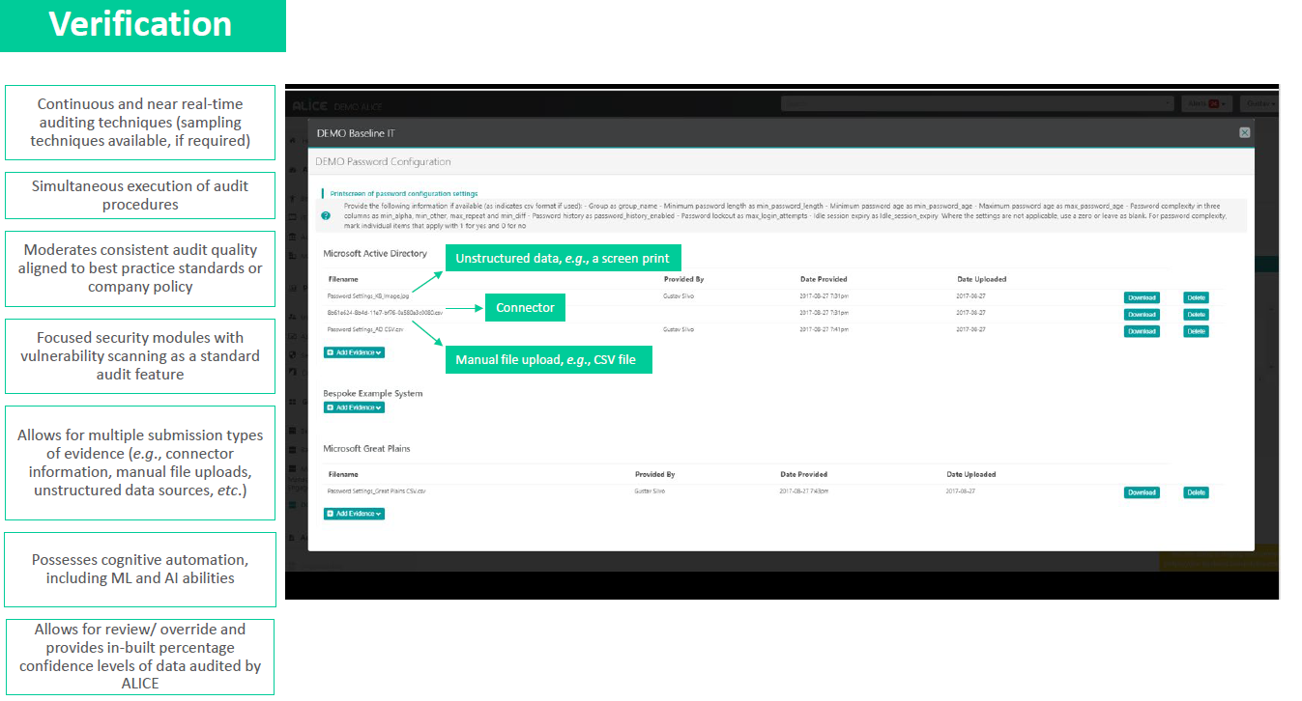
NITTY GRITTY – IT AUDIT

Slide 16
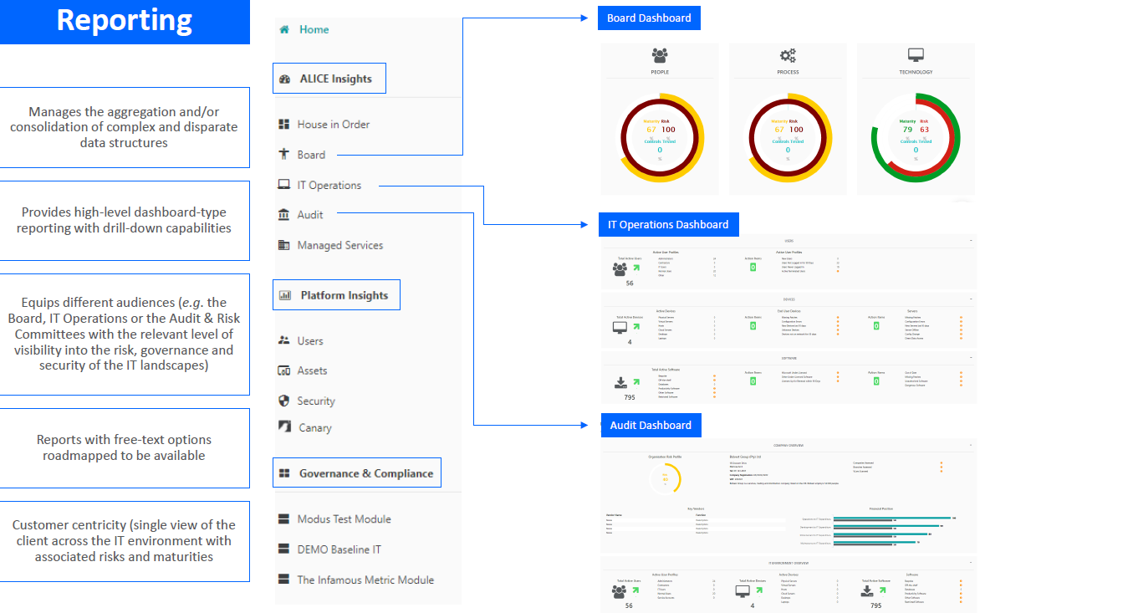
OUTPUT AND REPORTING

Slide 17
SUCCESSES VS CHALLENGES
Successes
Challenges
POC run at one of our highly complicated auditees - SARS
Internal admin – delays due to free POC
System limitations in client system – workaround tests
Tool run successfully
Audit output vs Manual was negligible
Team fears on what automation means for them

Slide 18

AND DATA ANALYTICS
  Without a goal, analytics is aimless and worthless - Michael Porter

Slide 19




DATA ANALYTICS- VALUE PROPOSITION
Audit programme
Unlock insights, new connections relationships and patterns
Inform conclusion and support decision-making
Risk identification
Substantive
audit evidence
Discover, mine and interpret useful information
Improve audit efficiencies, risk management and quality

Slide 20
DATA ANALYTICS IN SUPPORT OF AUDIT – MINIMISE AUDIT RISK
Tactical Analytics (CAATs)
Active Analytics (Analysis)
Descriptive
(Assertions CAATs-ACL)
Diagnostics
(PowerBI Dashboards)
Predictive
Prescriptive
Querying
Reporting
Trend Analysis/ Insights (Historical)
Advance Visualisation
Modelling
What if?
Machine Learning
Applied Statistics
Typically used for risk assessment and assertions testing
Used to predict future outcomes (e.g. at interim) and highlight emerging risks
Increased footprint – Multi-skilled Auditors
Future proof / Advise – Auditor Partner
Tactical analytics
Active Analytics
AGSA current state
AGSA Future state
Analysis
CAATs
Visualisation
Trend analysis
What if?
Statistical modelling

Slide 21
CURRENT STATE
Descriptive analytics
(Assertions/ Caats)
Diagnostic Analytics
(Insights)
ACL used as a tool of choice, over 100 licenses, used by IT auditors, Regularity Auditors and Fraud and investigations
Piloted at five (5) auditees – Proof of concept, utilising PowerBI
Tests to support audit objective i.e. Audit assertions, Risk response, risk materialisation, and control adequacy
Displaying data visually - makes it easier to see the bigger picture, etc.
Insights that drives audit decision making, identification of anomalies, trends, patterns, risk assessment, sampling
Used on over 1000+ auditees, testing of e.g. COI, SCM, revenue, HR, FI, Data migrations, ACR & GCR testing

Slide 22
DESCRIPTIVE ANALYTICS (ASSERTIONS BASED CAATS)
  We support about 700+ auditees/ clients in one audit cycle, which is a total of 1202 projects and spend 29 074 hours. Our Caats procedures ranges from 1 to 55 procedures per auditee/ client.

Slide 23

















DIAGNOSTIC ANALYTICS (INSIGHTS USING POWERBI)
  Introduced during 2021 with 5 pilots. Rolled out to 68 auditees/ clients during the 2022 audit cycle. Some examples:

Slide 24
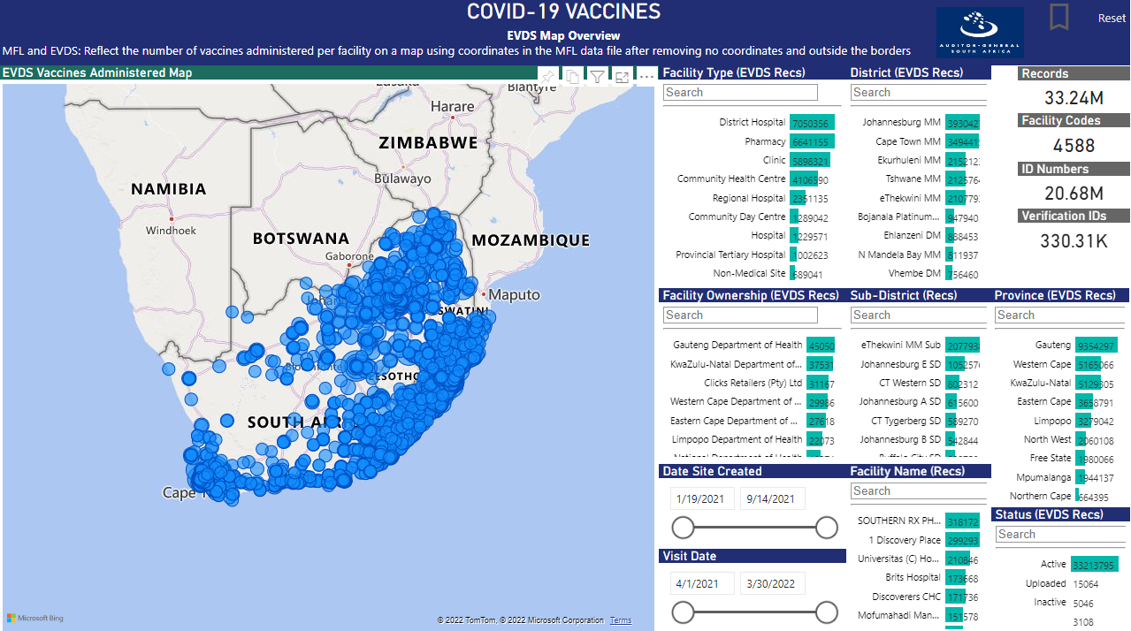
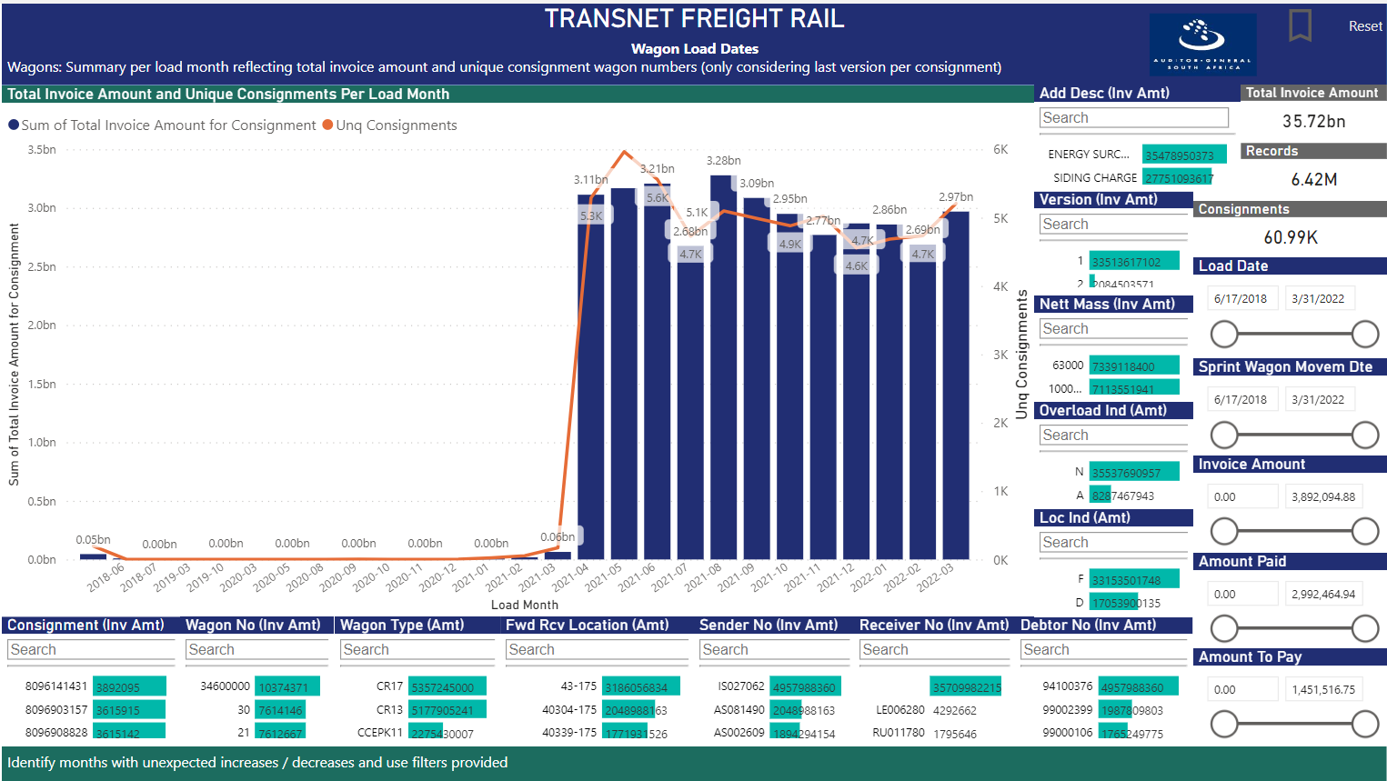
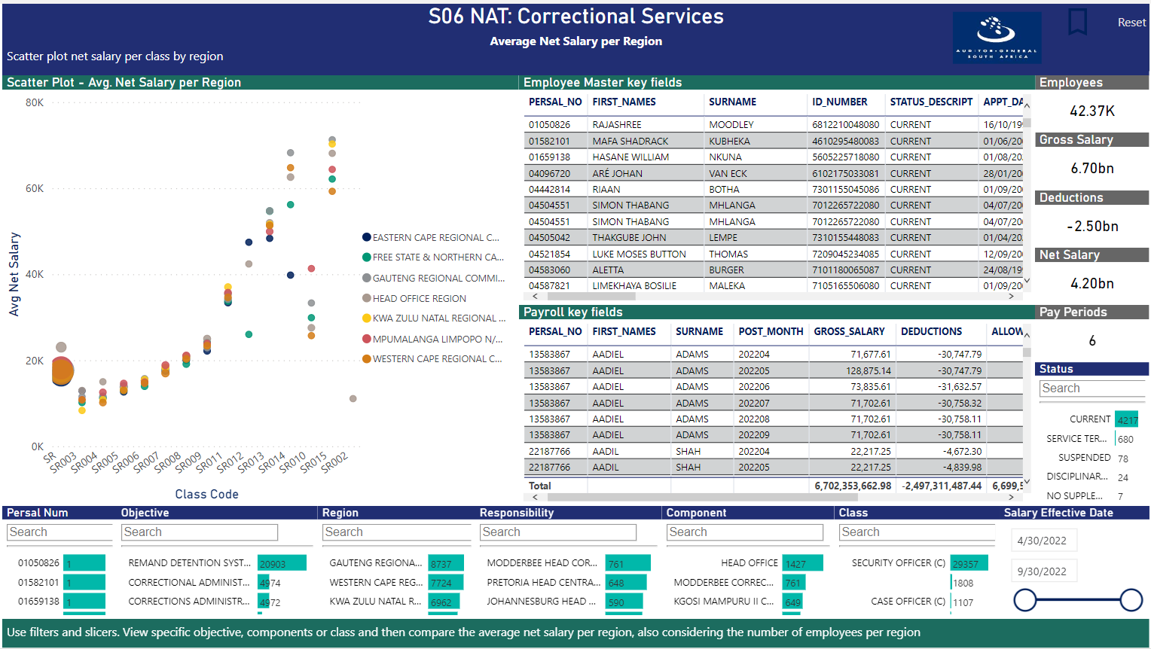
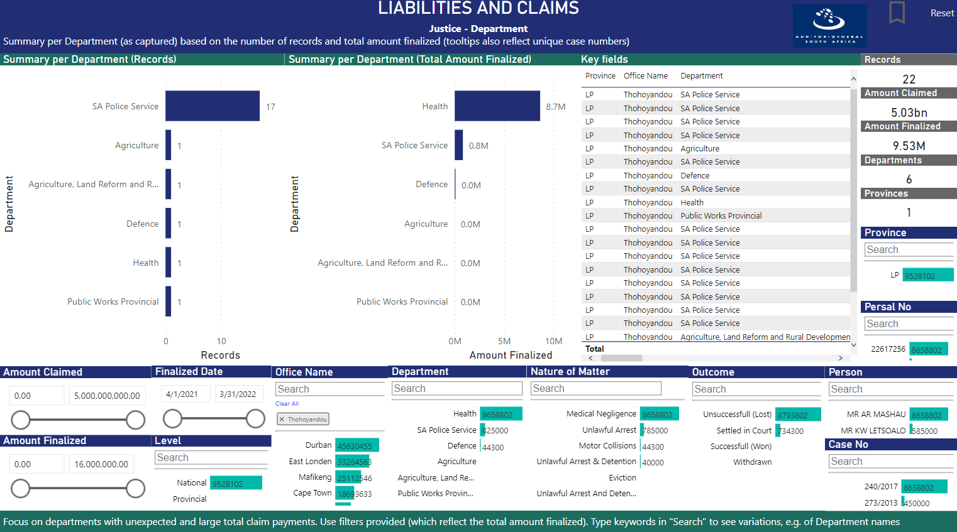
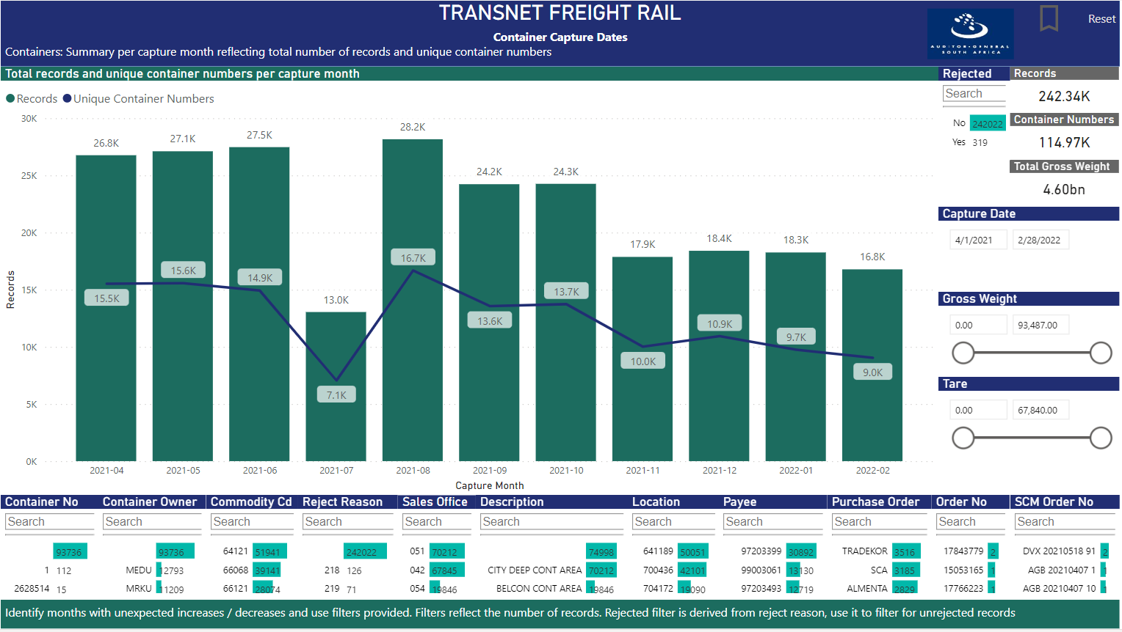
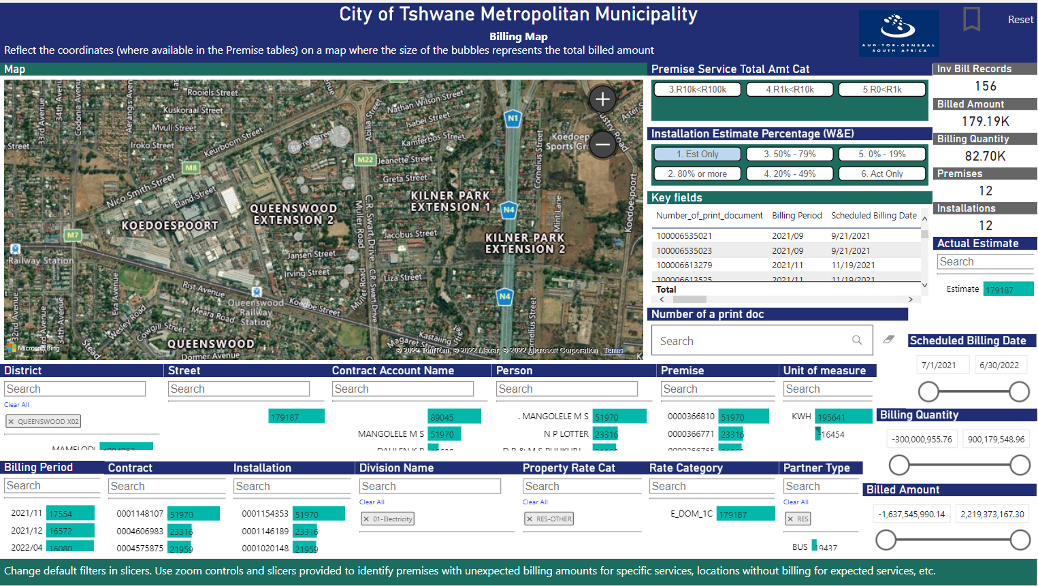
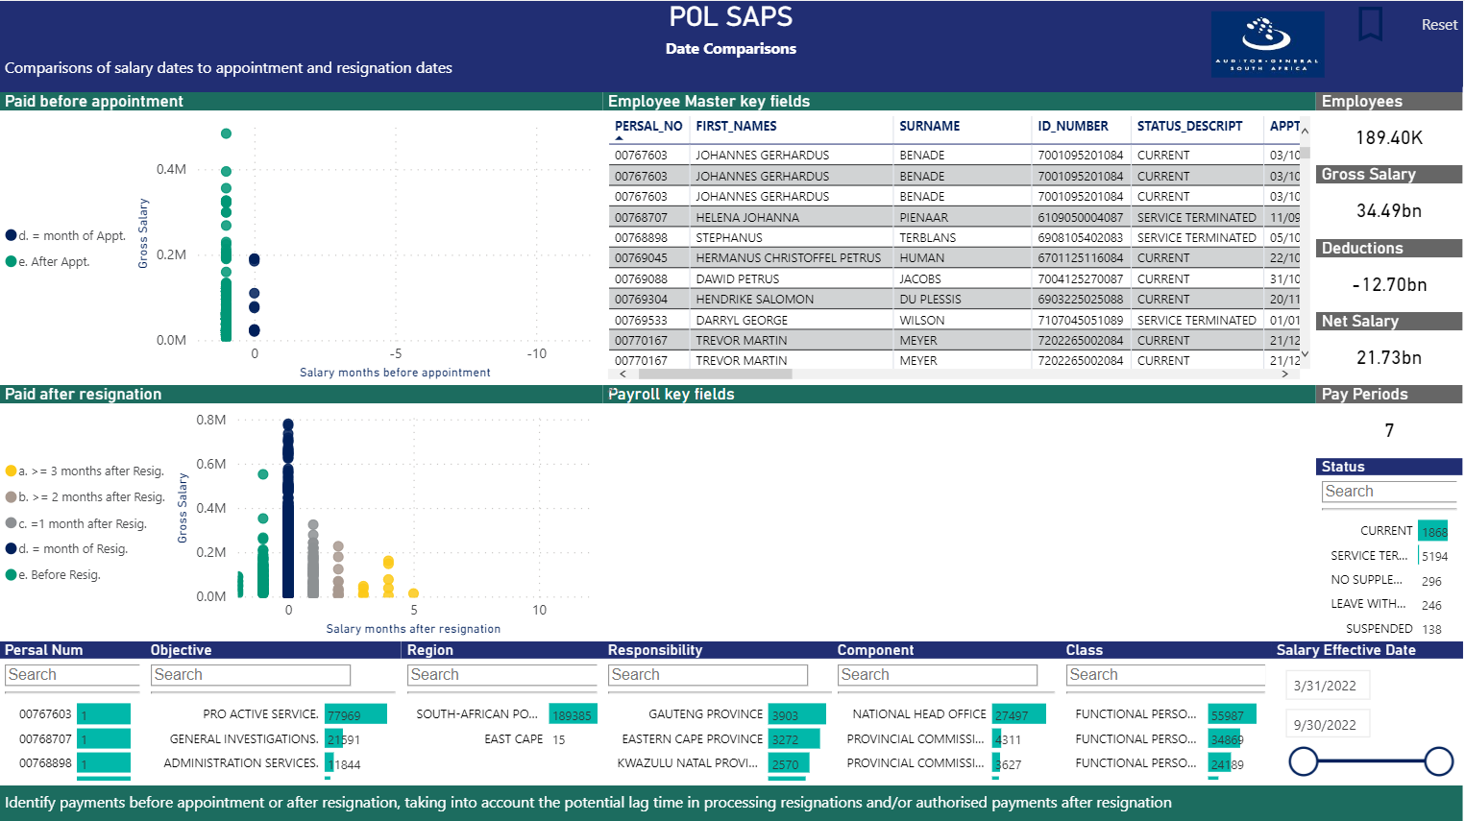
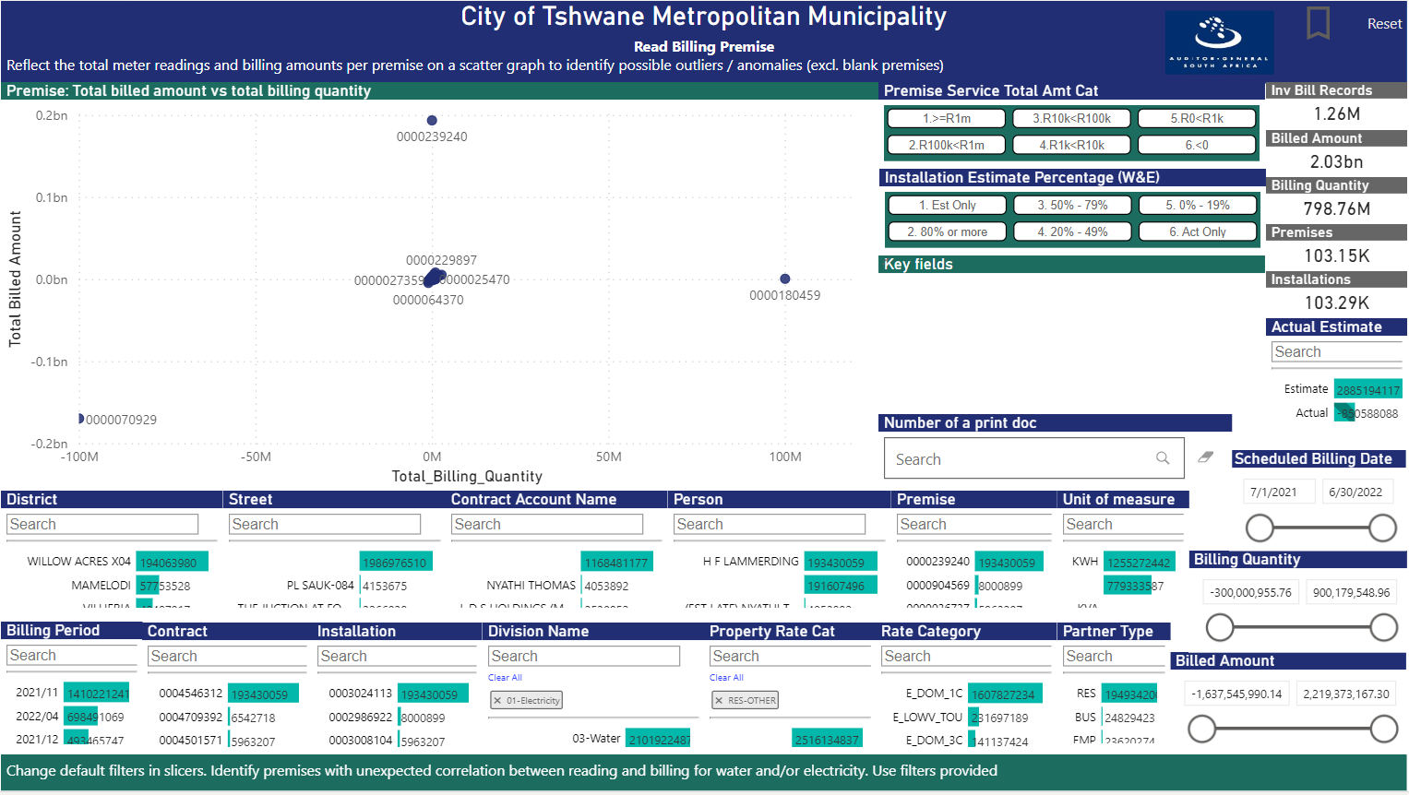
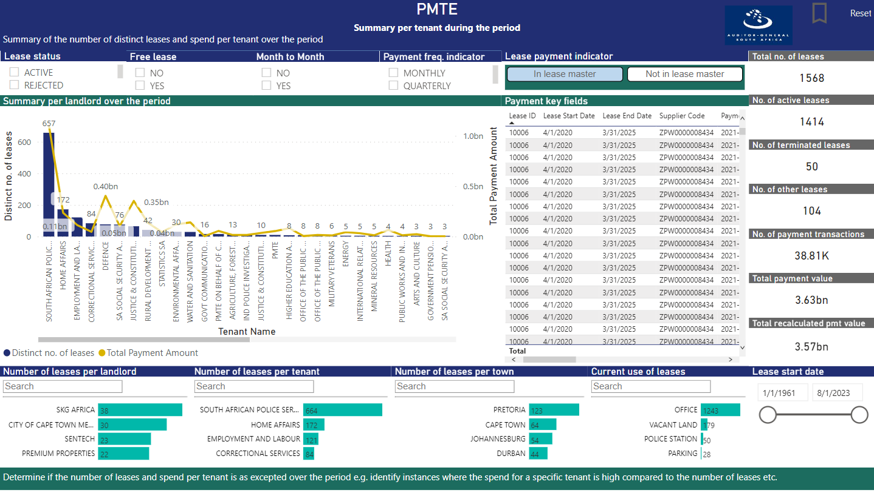
DIAGNOSTIC ANALYTICS (INSIGHTS) – EXMPLE DASHBOARDS

Slide 25
FUTURE DEVELOPMENTS – ACTIVE ANALYTICS
Audit Cycle 2023/2024 and 2024/2025
Predictive Analytics
Machine Learning
Artificial Intelligence

Slide 26
AUDITING TO
BUILD PUBLIC CONFIDENCE
THANK
Auditor General of South Africa
@AuditorGen_SA
Auditor-General of South Africa
YOU
www.agsa.co.za

