Slide 1
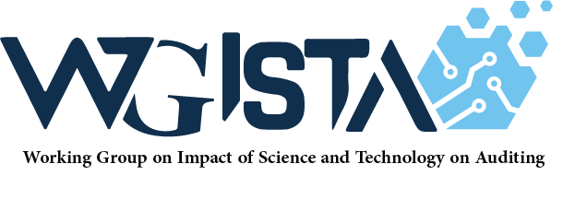

Emerging Trends in Government-wide Enterprise Applications and How AI/ML Can Impact Auditing
WGISTA 3rd Annual Meeting
Nadeem Hoda
Principal Cloud Engineer
December 2022
Copyright © 2022, Oracle and/or its affiliates. All rights reserved.

Slide 2
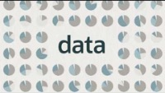
Audit is about DATA
2
Copyright © 2022, Oracle and/or its affiliates. All rights reserved.

Slide 3

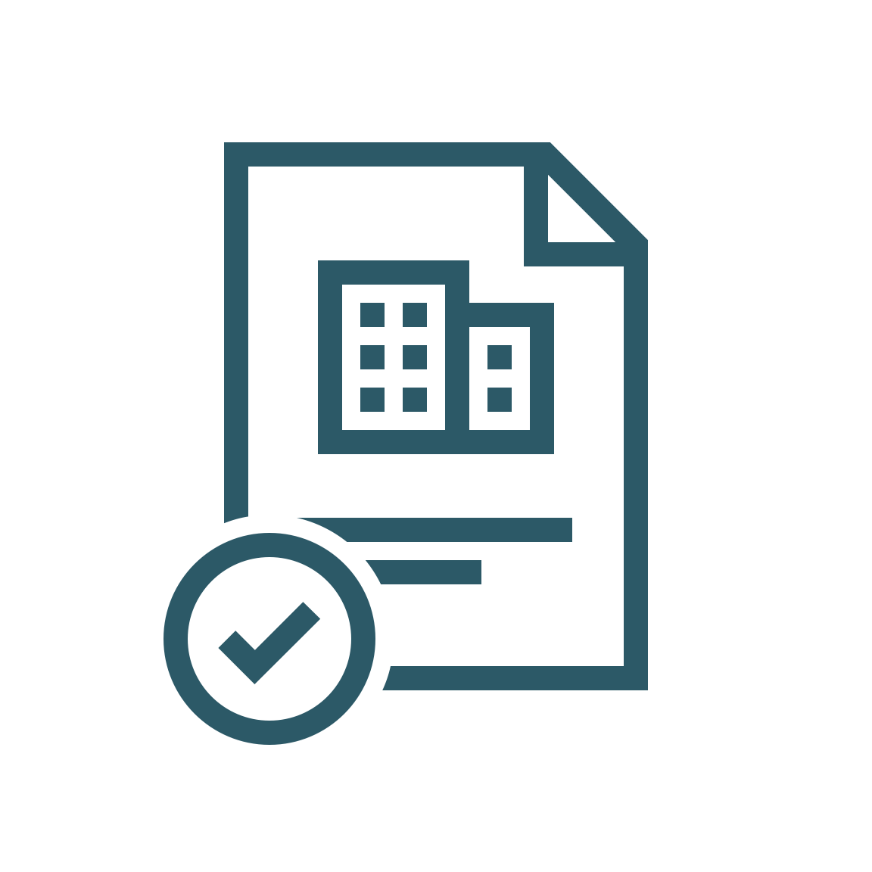

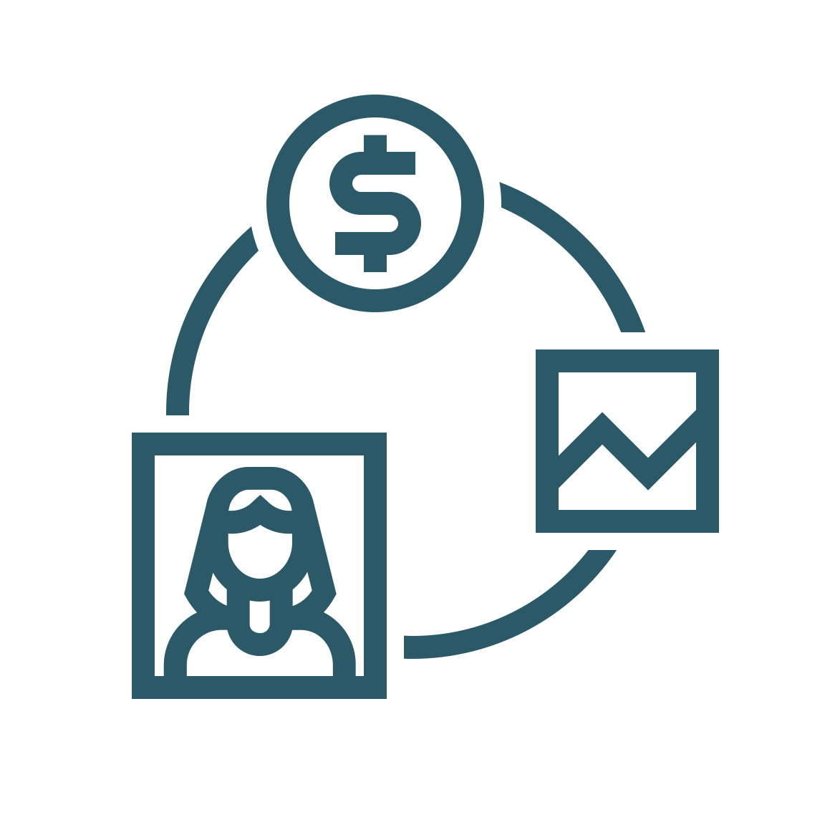






DATA can be fragmented and siloed in government contexts
Gov’t Challenges
Enterprise Apps
ERP Solution(s)
(on-prem)
Custom Solutions
Difficult to Adapt to Change
Expensive to Manage and Maintain
Siloed and Fragmented Systems and Info
Non-uniform Security
Custom
Files
j
j
j
j
j
Audit Challenges
Inaccurate Data & Poor Data Quality
Scattered and Inconsistent Data Sources
Lack of Data and Process Visibility
Difficulty Obtaining Information – Labor Intensive
On-Premise/Hosted Enterprise Apps
& Data
3
Copyright © 2022, Oracle and/or its affiliates. All rights reserved.

Slide 4
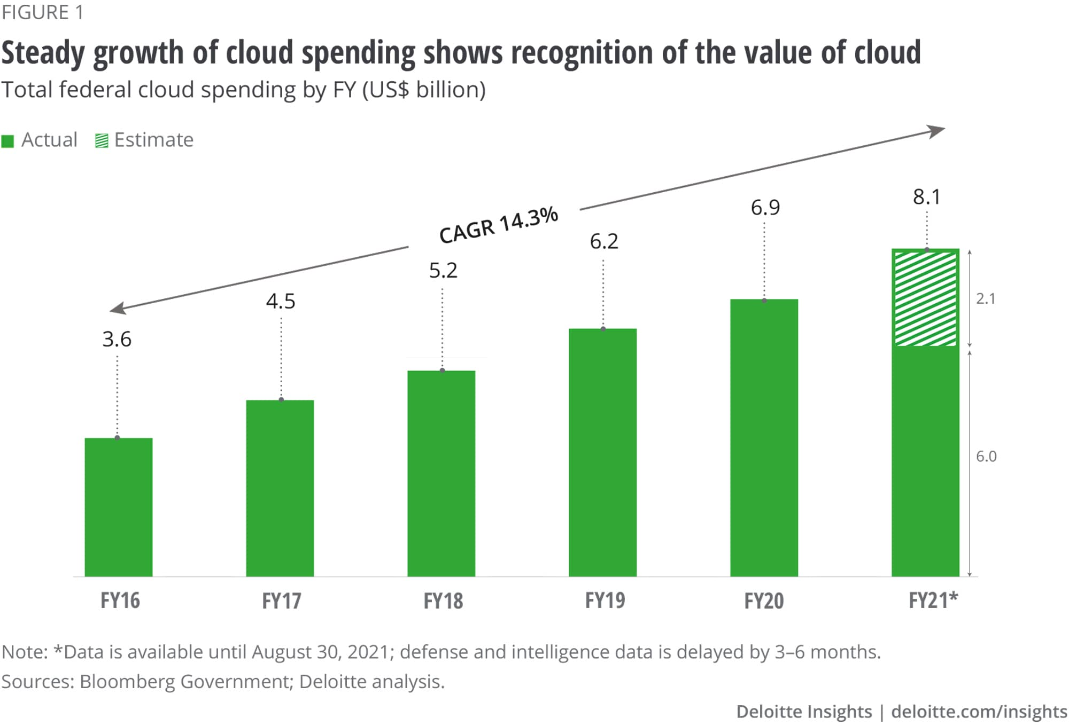
The government is moving to the cloud with their DATA
“Fifty-four percent of government CIOs … expect to allocate additional funding to cloud platforms in 2022, while 35% will decrease investments in legacy infrastructure and data center technologies.”
- Gartner, 2022
4
Copyright © 2022, Oracle and/or its affiliates. All rights reserved.
Sources:
https://www2.deloitte.com/us/en/insights/industry/public-sector/public-sector-cloud-adoption.html
https://www.gartner.com/en/newsroom/press-releases/2022-06-13-ww-govt-it-spending-forecast-2022
Notes:
Countries with Cloud Smart or Cloud First Policies: UK, US, Singapore, KSA and UAE is moving towards the cloud
Compound Annual Growth Rate

Slide 5
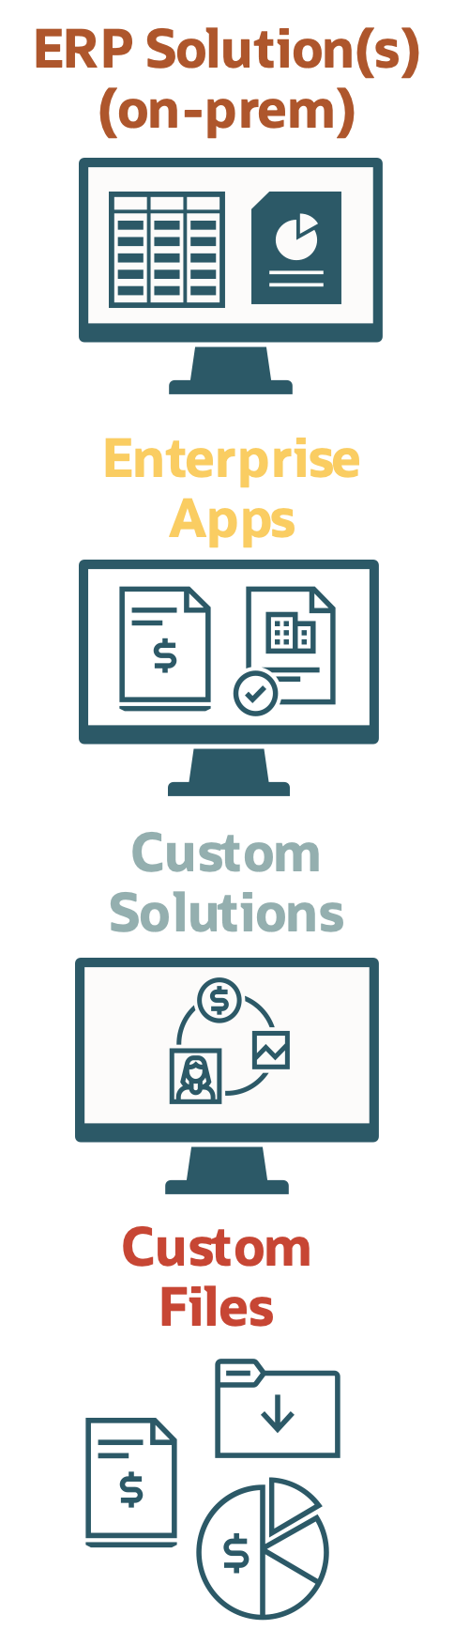
Moving to the cloud enables easy auditing leveraging DATA
Legacy IT Landscape
Modernized Cloud Solution
ERP
SCM
HCM
Gov’t Benefits
Connected Planning
Efficient Logistics
Easy to Manage and Maintain
Connected Systems and Info
Rapidly Adapt to Change
Uniform Security
migrate
Harmonized Financials
Perfect Order Fulfillment
Unified Analytics
Talent Lifecycle
Audit Benefits
Streamline Procurement
Manage Global Workforce
Increased Data Accuracy & Quality
Uniform Data Sources
Data and Process Transparency
Easy Data and Information Access
Built-in Audit Controls
Audit System
Existing Data Sources & Systems
Cloud Platform
5
Copyright © 2022, Oracle and/or its affiliates. All rights reserved.
Notes:
Oracle offers a full Financial Crime and Compliance Management solution

Slide 6
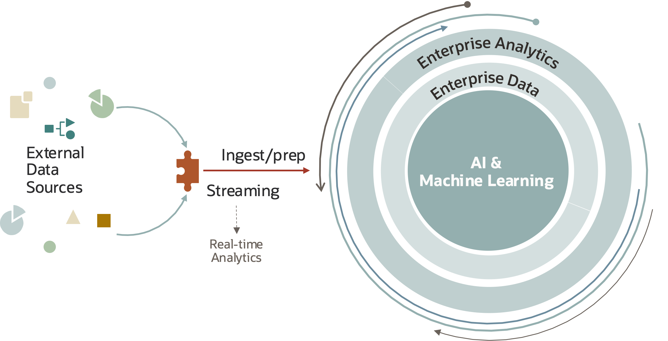
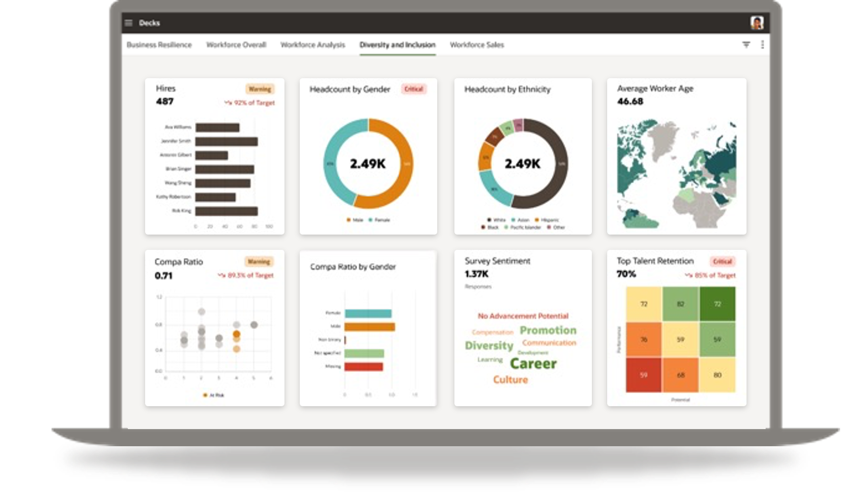
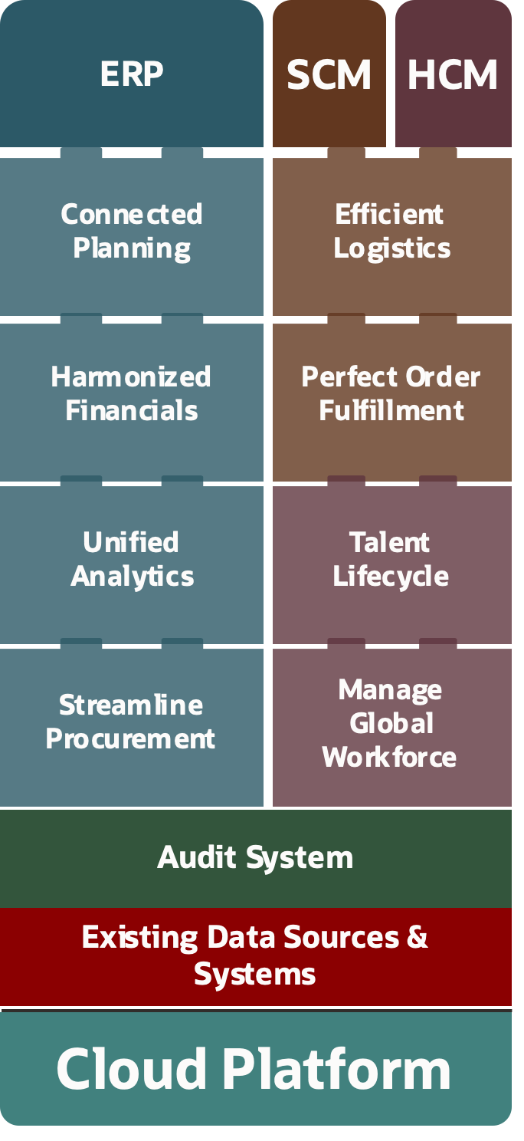

Adding AI/ML allows advanced and proactive auditing of DATA
Automated Audit IT Ecosystem
Continuous Auditing
Automated and Continuous Auditing
Notifications of Irregularities
Full coverage of transactions and employees
Advanced Auditing Capabilities
Proactive Reporting
Advanced Audit Dashboards
Advanced On-demand Reports
Follow-ups on Action Plans
Advanced Features
NLP Queries
were there any financial irregularities
in the month of May?
6
Copyright © 2022, Oracle and/or its affiliates. All rights reserved.

Slide 7





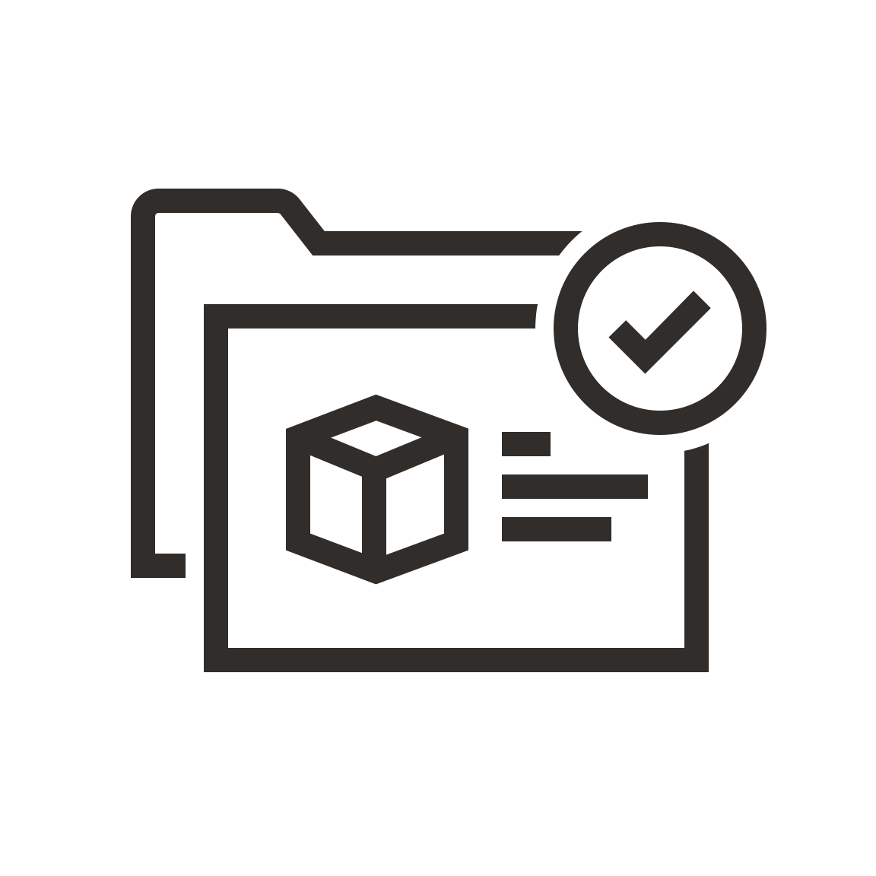

References
Social Insurance Analytics
Fraud Detection
Client Risk Mgmt and Fraud Prevention:
Machine Learning Applied to Data
Predicting payment behavior:
individuals’ Personal Payment Behavior
The UK National Health Service (NHS) covers the publicly-funded healthcare systems of the UK.
The NHS transferred more than 15 billion rows of data into Oracle Data Management Platform
The NHS identified up to GBP100 million (US$156 million)
across the NHS through benefit fraud and error reduction
The NHS analyzed billions of records at one time to measure longer-term patient journeys and to analyze drug prescribing patterns to improve patient care
Certegy provides a low-risk payment authorization platform for businesses.
Certegy helps over 4,000 customers in industries including retail, auto, and home improvement to manage risk, prevent fraud and recover losses.
Certegy ingests data to ADW from more than 15 different sources, both in the cloud and on-prem. The company uses Oracle In-Database Machine Learning in ADW to calculate risk scores, enabling retailers to decide whether to accept or deny a check. Spatial analytics enables the company to track behavior patterns by location.
Social Insurance Agency, operates and sponsor many types of social insurances such as National Pension Insurance, Labor Pension Insurance, etc. in response of Country population ageing, social insurances is going to encounter a crisis of pension bankruptcy.
Consequently, the Agency Developed Deep-Learning framework on Oracle ADW Cloud Service and Connected it to different data sources; to build a prediction model to predict:
Predict future payment behavior with a long-term period.
Long term cashflow calculation
7
Copyright © 2022, Oracle and/or its affiliates. All rights reserved.
Notes:
Social Insurance Organization:
Social Insurance Agency, operates and sponsor many types of social insurances such as National Pension Insurance, Labor Pension Insurance, etc. in response of Country population ageing, social insurances is going to encounter a crisis of pension bankruptcy.
Consequently, the Agency Developed Deep-Learning framework on Oracle ADW Cloud Service and Connected it to different data sources; to build a prediction model to predict:
Predict future payment behavior with a long-term period.
Long term cashflow calculation
(National Office for Family Allocations, or CNAF)
As part of the plan to combat poverty in 2015-2017 and the creation of the Activity Premium, the CNAF has chosen Oracle Cloud as its online simulator system. This digitized and personalized system makes it possible to simplify the users' procedures, but also to reduce travel and thus save on energy.
Thanks to this online device, French people can now check their eligibility for the Activity Premium and get the amount they are due directly from their laptop, smartphone or tablet.
*The "Activity Premium" is a financial allowance aimed at encouraging people to find work and increasing the buying power of those on low income.
New deployment of the social aids using a business rules engine to calculate the allowance – Chose Oracle Policy Automation for this (OPA)
The CNAF had also enabled frictionless services where users don’t need to request a service, they proactively receive eligibility notification and upon verification funds deposited directly to beneficiary bank account.
Oracle Cloud selected for security, performance & cost
OCI + Oracle SaaS
5 months - Decision -> Live
Live serving 30 million citizens
120 million API requests/day
CNAF now offer 25 additional social benefits
National Health Service
The NHS Business Services Authority is an executive non-departmental public body of the Department of Health which provides some support services to the National Health Service in England and Wales
Summary
NHS use machine learning to improve patient outcomes, optimize internal processes and reduce fraud. They have identified £1billion in ongoing annual savings.
Business Challenge
It provides a range of critical central services to NHS organizations, contractors, patients, and the public. Services include managing the NHS Pension schemes in England and Wales, managing payments to primary care dental and pharmacy contractors, and administering the European Health Insurance Card (EHIC).
The department wanted to take a proactive role to identify opportunities to reduce costs and eliminate waste. One way to do this was to find better ways to use the vast volumes of data already collected and held within the organization to help reduce fraud and error throughout the health service.
The department needed a new, centralized solution that would enable it to gain better value from its data which is spread across a disparate set of IT systems, data, storage, and analytical capabilities. To achieve this, it chose an end-to-end Oracle solution including Oracle Analytics Cloud,.
It wanted to use new insights gathered from data to help identify cost savings and meet NHS strategic goals and to identify and prevent healthcare fraud and benefit eligibility errors to save costs.
In addition, the NHS needed to take advantage of existing data to transform business and productivity.
Why Oracle?
With Oracle's solution, the NHS established its Data Analytics Learning Laboratory (DALL), investing in both technology and expertise to create insight from its data. Within the first three months of operation, the organization identified circa GBP100 million (US$156 million) in potential savings.
NHS used analytics to identify significant savings within NHS dental services and find instances of activities which do not demonstrate good value for money.
“With Oracle Analytics, it is much easier to detect anomalies in behaviors. We used anomaly detection to discover where there might be evidence of inappropriate behavior in claims, enabling NHS commissioners to follow up and challenge their activities,”
The EHIC is available to all European citizens covered by a statutory social security scheme and entitles them to free healthcare while visiting other European countries.
During an analysis of EHIC data, the NHS discovered commercial addresses being used fraudulently to apply for EHIC cards and uncovered the use of invalid NHS and National Insurance numbers to apply for a card.

