Slide 1
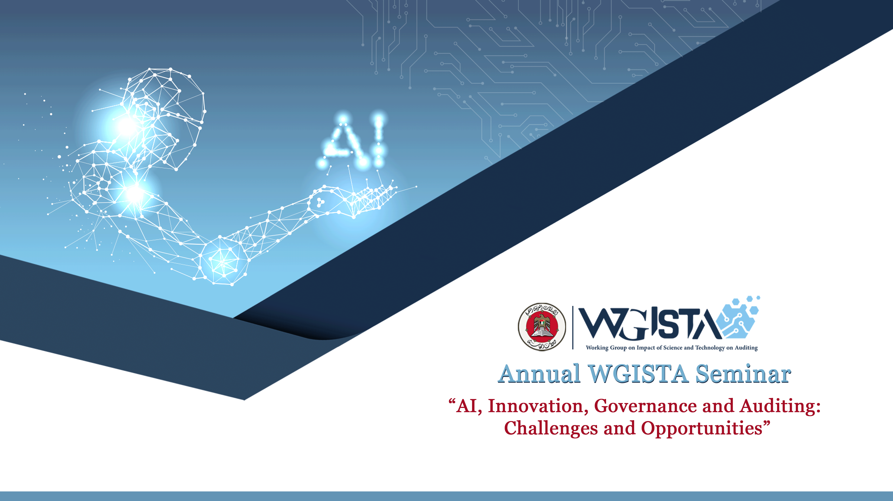


Slide 2

“AI, Innovation, Governance and Auditing :
Challenges and Opportunities”
“Technology as an Enabler for Audit”
Mr. Abdulla Mohamed Alshehhi - SAI UAE

Slide 3

Presentation Outline:
SAI UAE In The Digital Era
SAI UAE Digital Strategy
Advanced Technology Infusion in SAIUAE Audit Services:
  Robotic Process Automation (RPA)
  Machin Learning (ML)
  Critical Success Factors
  Use-Case
Future Roadmap

Slide 4
1. SAI UAE in the Digital Era:
    Data proliferation beyond manual capabilities
    Hidden data relationships that cannot be covered by traditional approaches
    Information that exists only on the digital realm
    Real-time data surveillance that can be done only with technology

Slide 5
2. SAI UAE Digital Strategy: [A Timeline]
Creation of an Analytics Powered Risk based approach to FA and IS Audit
Implementation of HR and G&S analytics across all federal entities
Redefined Data Analytics and planned/achieved milestones towards harnessing Advanced Technology
2010
2018
2020
First real-application of data analytics, powered by ACL
2016
2019
Full-scale Implementation of a Smart Audit Platform utilizing different technologies
2021 - Present
Launched Data Mart and initiated Digital Transformation of Audit

Slide 6
3.A. Advanced Technology Infusion in SAIUAE Audit Services: [Robotic Process Automation (RPA)]
In 2021, SAI UAE began researching the implementation of RPA to automate its analytical workflows.
As of 2022, successfully built workflows that help automate end-to-end processes, from data gathering to output execution.
Working on this technology has allowed SAI UAE to realize the following benefits:
  Achieving higher level of assurance
  Gain Deeper Insights
  Increased Efficiency

Slide 7
3.B. Advanced Technology Infusion in SAIUAE Audit Services: [Machine Learning (ML)]
In 2021, SAI UAE has initiated the Machine Learning Pilot Project to test the application of ML on refining the results of analytical processes.
Through testing the sample results produced by ML, it has revealed further avenues for improvement, particularly in addressing the following challenges related to the way ML models interpret results and the provision of quality data.

Slide 8
3.C. Advanced Technology Infusion in SAIUAE Audit Services: [Critical Success Factors]
Regardless of technology, SAI UAE predicates itself on the following critical success factors, to the success of any technology:
  Data Quality:
    The quality of the output can only be as good as the input.
    SAI UAE is investing effort to increase the sophistication of its databases that houses client data
    Multiple workflows has been designed to evaluate the quality of data and ensure minimum standards are met before analysis
  Auditor Upskilling
    To ensure that the outputs are effectively being used to produce quality insights, auditors must be equipped with the knowledge to make the most out of the data
    A proactive approach is taken to help auditors improve their skills and research new technologies.

Slide 9

3.D. Advanced Technology Infusion in SAIUAE Audit Services: [Use-Case : Transactions Fee Revenue]
The use case was conceived during the audit execution phase.
Consultation with the financial auditors.
The DA team then identified ways to bridge the gap between technology and traditional procedures, utilizing the following technologies:
  Analytical Process Software – Using in-house Smart Platform
  Artificial Intelligence – Using Optical Character Recognition (OCR)
  Automation – Using Robotic Processing Automation (RPA)

Slide 10



Challenge Points:
Pain Point 1
Comparing the sheet information to the actual amount received from image-based receipts.
  > Solved using AI - OCR
Pain Point 2
- Analyzing information over 330 sheets on monthly basis.
> Solved using RPA

Slide 11
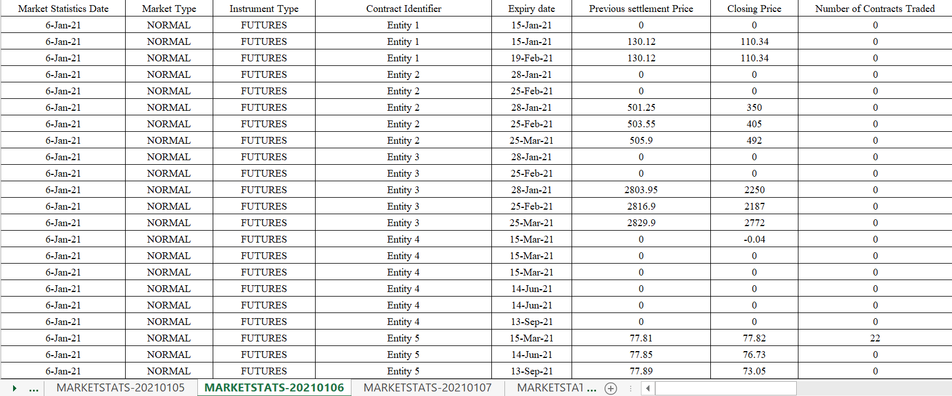
Sample of Data Used:
3- Helps determine how much transaction fee should be earned per party
2- Identifier to sum actual transactions by party
1- Market Statistics are divided by days.

Slide 12








Transaction Fee Recalculation Illustrated:
i
Step 0: Get Data
Step 1: Data Cleaning & Transformation
Step 2: Analysis & Output
Cash Receipt Information
Contract Information (rates etc.)
Data to Compare Against
Market Data
Cash Receipt Information
(.pdf)
Market Data
(.xlsx)
Apply OCR
Data to Compare Against
Perform Analysis
Contract Information (rates etc.)
Market Data
(.xlsx)
Market
Data
Consolidate
Get Output

Slide 13

Transaction Fee Recalculation Post-Automation:
(1) Market
(2) Contract Info
(.xlsx)
Cash Receipt Information
(.pdf)
Analytics Engine Automated Workflow
Output in desired form
Entire process is run by RPA bot.

Slide 14

Overall From Revenue Use Case
The Goal: Recalculation of the transactions fees and compare it to the actual received & Automate the process.
Work Done: A workflow was built to aggregate the data and match it with the actuals using OCR technology. This process was automated to roll-it-forward on a monthly basis using RPA.
Result: Lost in government revenue.

Slide 15
4. Future Roadmap
Exploration of unstructured data and building workflows to support this form of analysis i.e. sentiment analysis.
Creating large-scale data warehouses using big data technology, to enable rapid processing and benefit more from AI-based solutions.
Continued refinement of existing capabilities via lateral improvements (creating analytical workflows in a wide variety of tools and integrating them under one platform).

Slide 16
Sessions’ Takeaway
Seize the opportunities that emerging technologies offers, while keeping an eye on critical success factors.
“A chain is as strong as the weakest link” – all stakeholders are equally important as collaboration is a cornerstone in adopting new technologies.
Keep reiterating on your organizational capabilities. What works today might not work tomorrow.

Slide 17

Thank You

